Slide 1
Growing Up - Puberty
Ages 9-12
© Miracle Foundation 2020

Slide 2
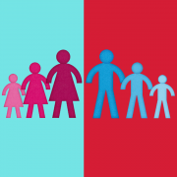
What is Puberty?
© Miracle Foundation 2020
Notes:
WHAT IS PUBERTY? Puberty is the time when your body begins to develop and change as you grow from child to adult.

Slide 3
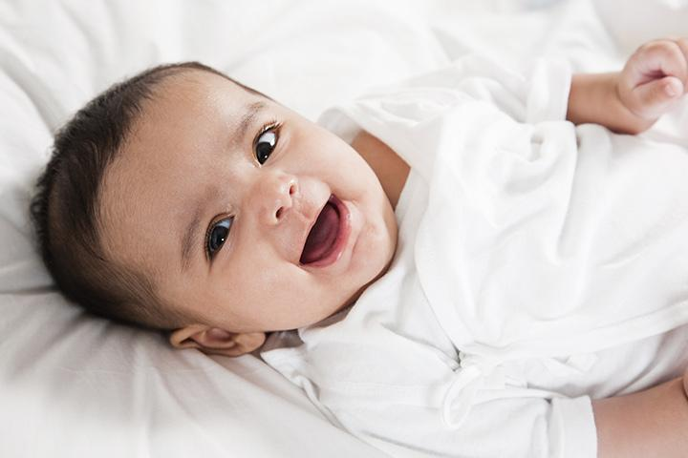
What Happens to My Body?
© Miracle Foundation 2020
Notes:
WHAT HAPPENS TO MY BODY? During puberty your body will grow faster than any other time in your life, except for when you were a baby.

Slide 4
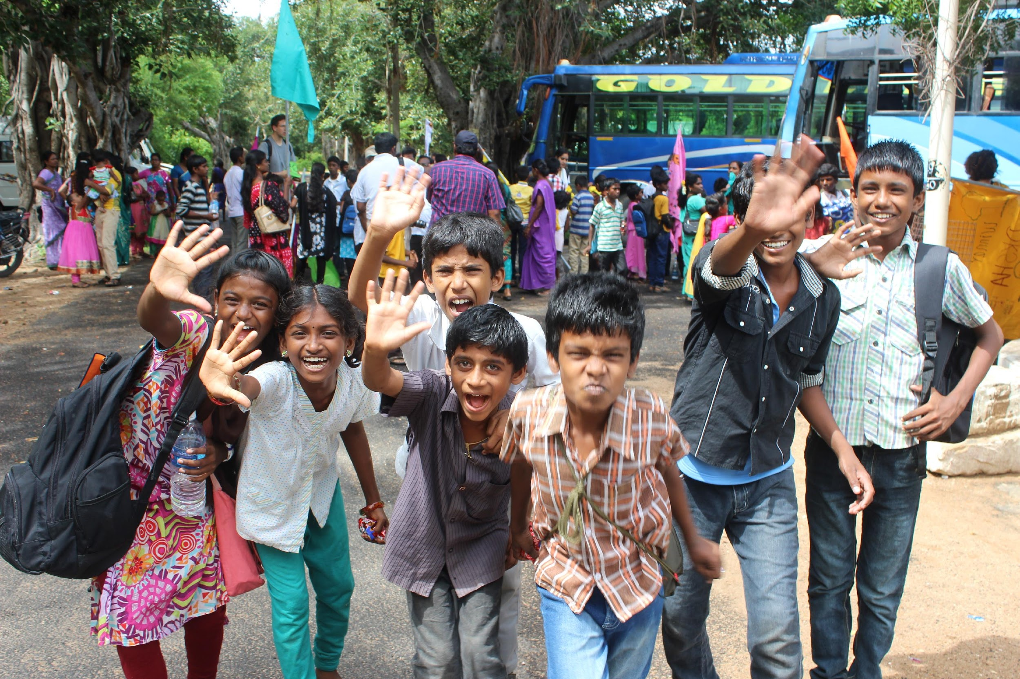
Who goes through Puberty?
© Miracle Foundation 2020
Notes:
WHO GOES THROUGH PUBERTY? Everybody goes through these changes - no two people are exactly alike, but everybody goes through puberty. It helps to know about the changes that puberty causes before they happen. That way, you know what to expect.

Slide 5
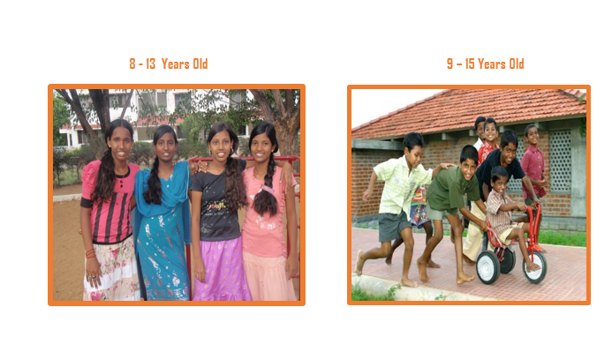
When does it Start?
© Miracle Foundation 2020
Notes:
WHEN DOES IT START? Puberty doesn’t start on a specific date – like your 10th birthday. It’s different for everyone. And puberty has different schedules for girls and boys. Usually, puberty starts between ages 8 and 13 in girls and ages 9 and 15 in boys. This wide range in ages may help explain why some of your friends still look like a child, where others look more like adults.

Slide 6
It’s Not a Race
© Miracle Foundation 2020
Notes:
Puberty is not a race. There is no shame in being the last in your class to hit puberty, and there’s no shame in being first. Puberty happens when it happens, and every person has his/her own schedule.

Slide 7
How long does it last?
© Miracle Foundation 2020
Notes:
HOW LONG DOES IT LAST? Again it’s different for each person. Some girls and boys develop quickly, taking only 2-3 years to go through most of the changes. For other kids, the changes of puberty will take longer, maybe 4-5 years. Puberty doesn’t happen all at once – it is a slow, gradual change.

Slide 8
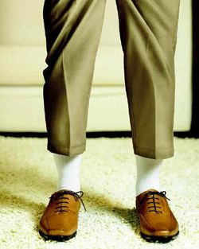
Physical Changes
© Miracle Foundation 2020
Notes:
PHYSICAL CHANGES: When you are ready to begin puberty, your body releases special hormones. Depending on whether you're a boy or a girl, these hormones go to work on different parts of the body.
During puberty you get bigger and taller. Girls’ bodies usually become curvier and their hips get wider. A boy's shoulders will grow wider and his body will become more muscular. The growth spurt lasts 2-3 years. You may find your clothes don’t fit the same as they did.

Slide 9
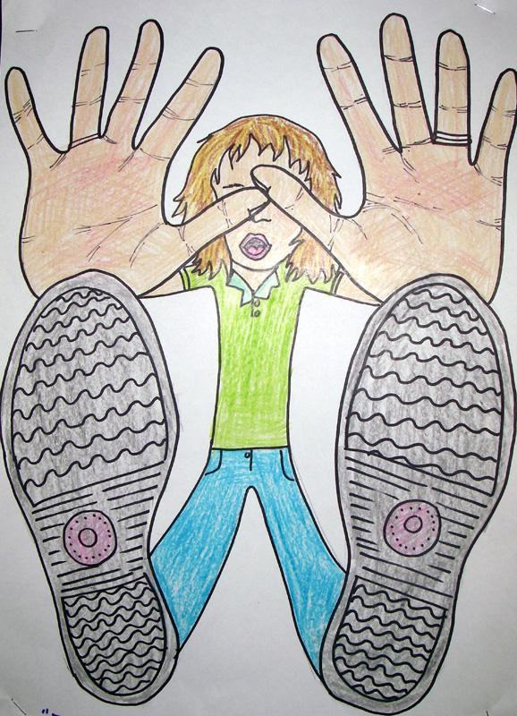
Physical Changes
© Miracle Foundation 2020
Notes:
Your arms, legs, hands and feet may grow faster than the rest of your body. You may feel clumsy and awkward adjusting to your new body.

Slide 10
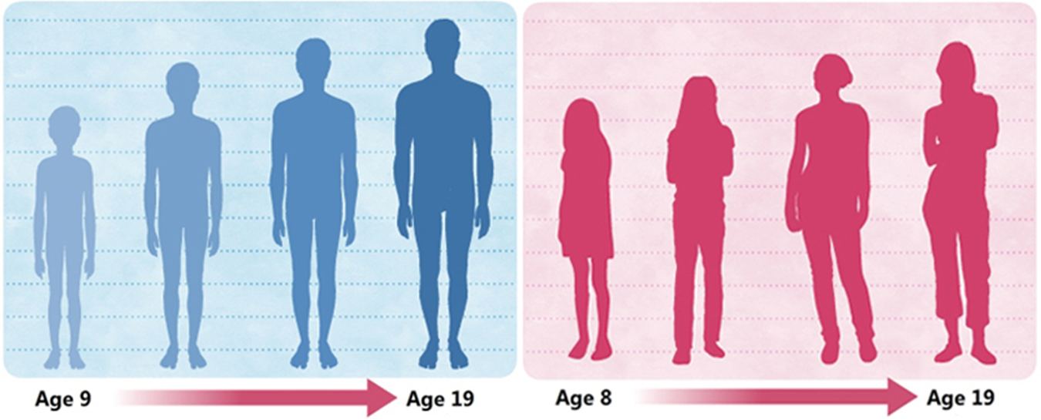
Physical Changes
© Miracle Foundation 2020
Notes:
Boys’ voices crack and eventually become deeper; girls’ breasts develop; boys and girls grow hair under arms and in pubic areas; boys will grow hair on their faces; and acne is caused by all the hormones at work in the body - you might see pimples on your face, upper back or upper chest.

Slide 11
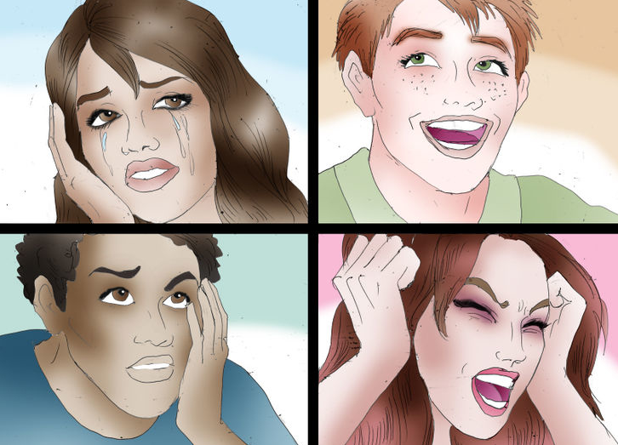
Emotional Changes
© Miracle Foundation 2020
Notes:
EMOTIONAL CHANGES: During puberty you might feel confused or have strong emotions that you’ve never had before. You might feel really sensitive or become upset easily. Sometimes it can be hard to deal with all these new emotions. One minute you may feel on top of the world, and the next minute you may feel down in the dumps. Talk to your house parent or social worker if it gets overwhelming.

Slide 12
It’s OK
© Miracle Foundation 2020
Notes:
IT’S OK! All of these changes can make you feel nervous or scared. Remember, the changes happening are normal.

Slide 13
Thank you!
© Miracle Foundation 2020

