Slide 1
Life Skills
Ages 13+
© Miracle Foundation 2020

Slide 2
Types of Skills
Skills
Life Skills
Livelihood Skills
Daily Living Skills
Learning Skills
Health Skills
Survival Skills
© Miracle Foundation 2020

Slide 3
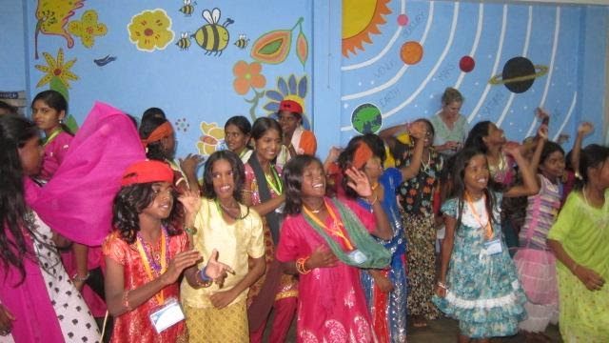
What are Life Skills?
Life Skills help us deal with the demands and challenges of everyday life
They assist us in accomplishing our goals and living to our full potential
© Miracle Foundation 2020

Slide 4
Three Kinds of Life Skills
Social
Thinking
Emotional
© Miracle Foundation 2020

Slide 5
Ten Core Life Skills
Social Skills
Self-Awareness
Effective Communication
Thinking Skills
Critical Thinking
Creative Thinking
Emotional Skills
Interpersonal Relationships
Empathy
Problem Solving
Decision Making
Coping with Emotions
Coping with Stress
© Miracle Foundation 2020

Slide 6
Social Skills
Self-Awareness
Effective Communication
Interpersonal Relationships
Empathy
© Miracle Foundation 2020

Slide 7
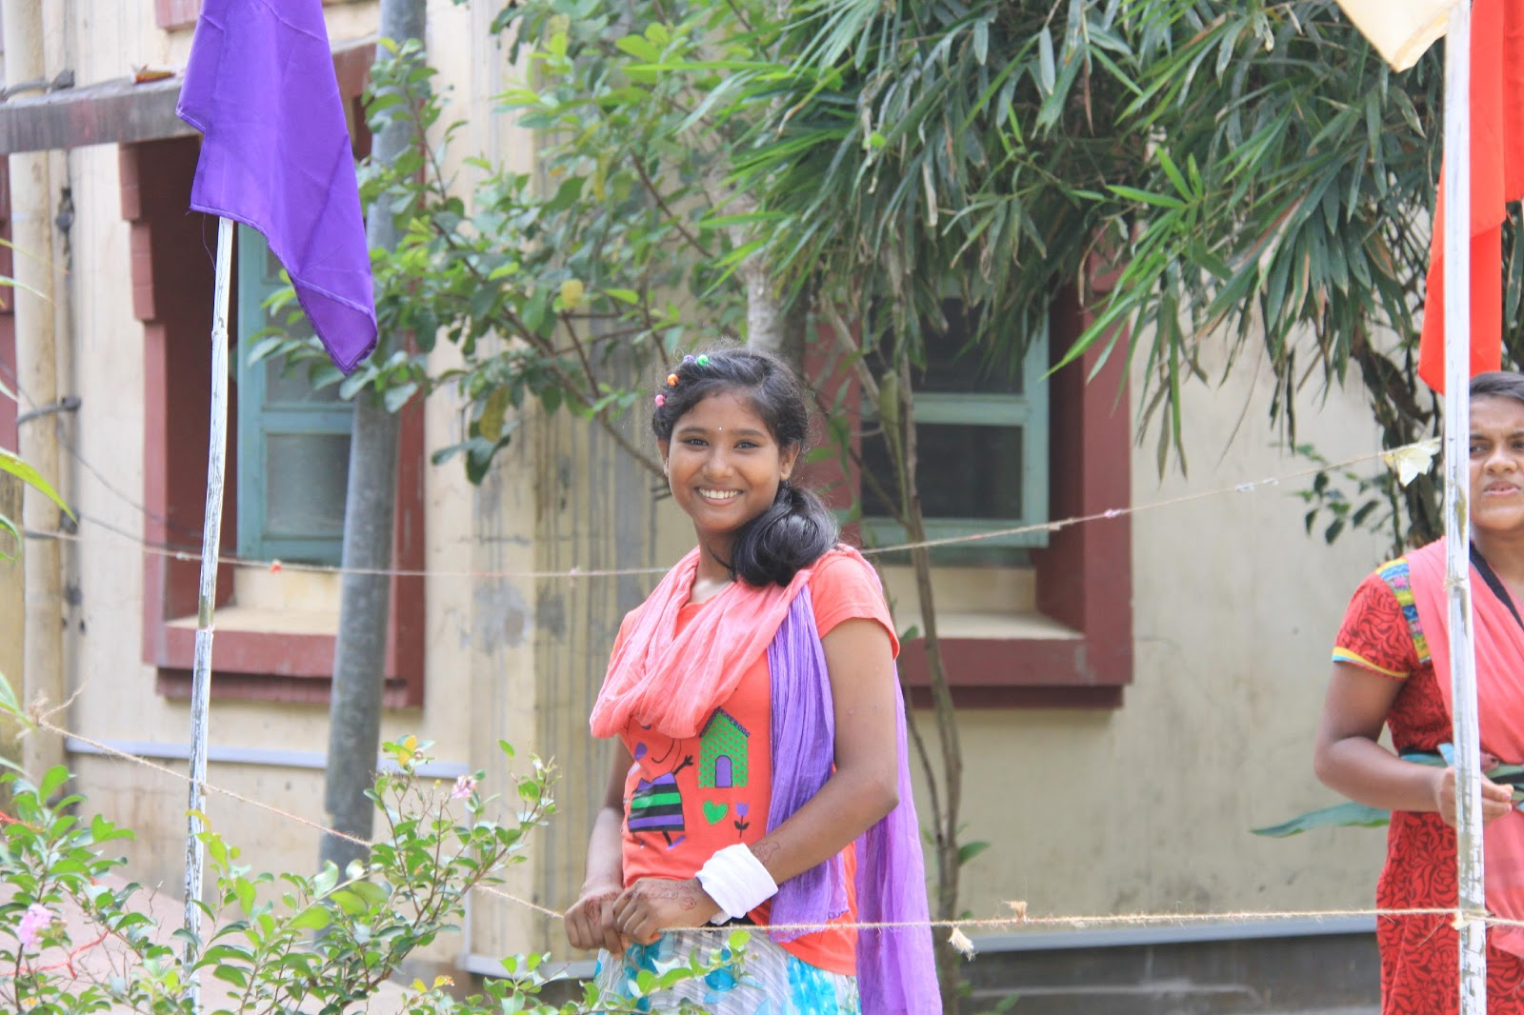
Self-Awareness
Recognizing your strengths, beliefs, likes, values, and character
Knowing about yourself helps in making decisions and setting goals
© Miracle Foundation 2020

Slide 8
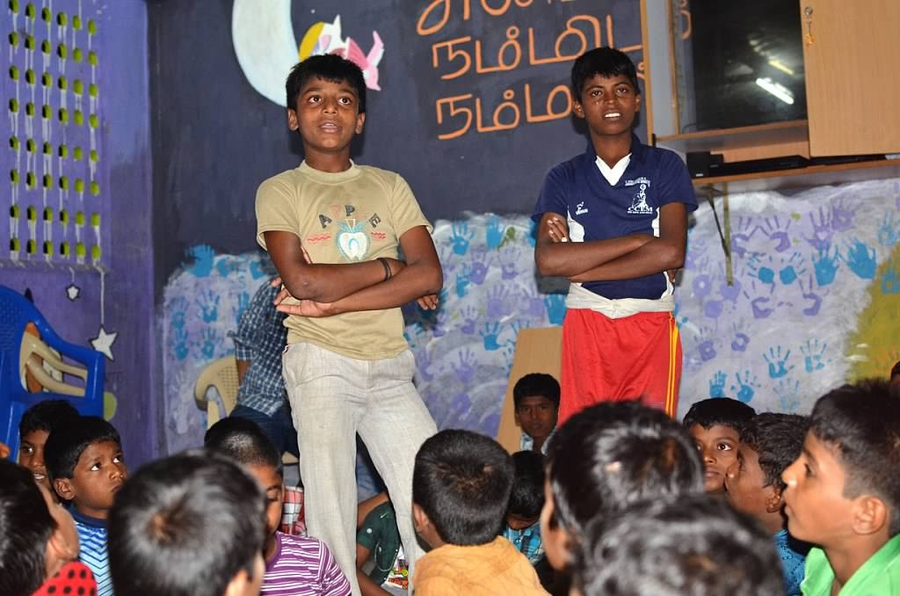
Effective Communication
Clearly expressing yourself verbally and non-verbally
© Miracle Foundation 2020

Slide 9
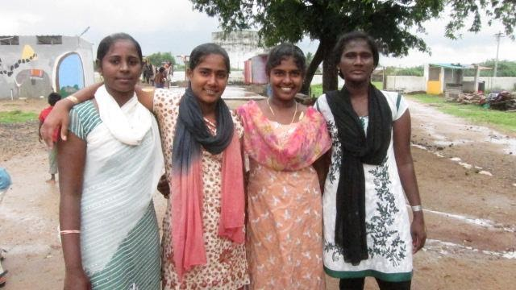
Interpersonal Relationships
Relating to people in a positive way
Making and maintaining friendly relationships
© Miracle Foundation 2020

Slide 10
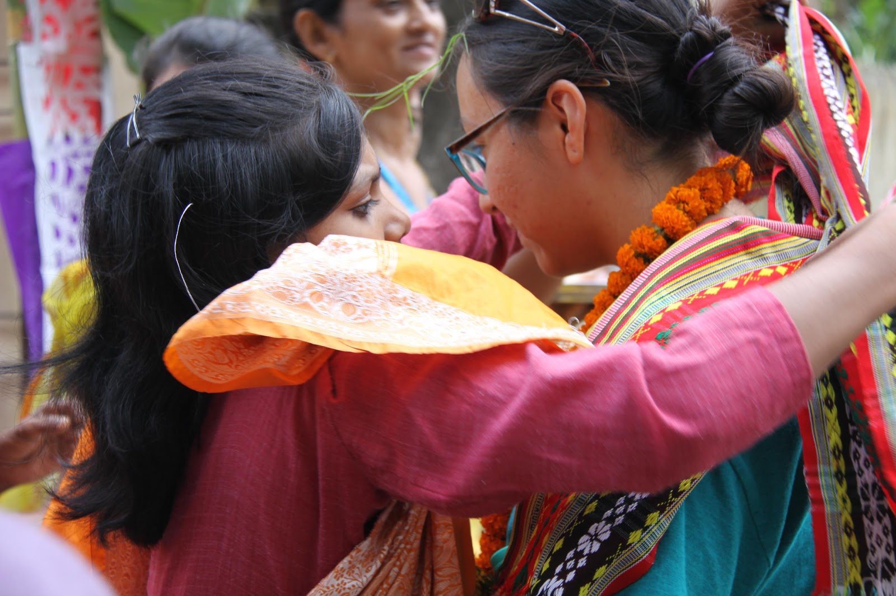
Empathy
Accepting others who may be different from you
Being sensitive to another person’s situation
© Miracle Foundation 2020

Slide 11
Thinking Skills
Critical Thinking
Creative Thinking
Problem Solving
Decision Making
© Miracle Foundation 2020

Slide 12
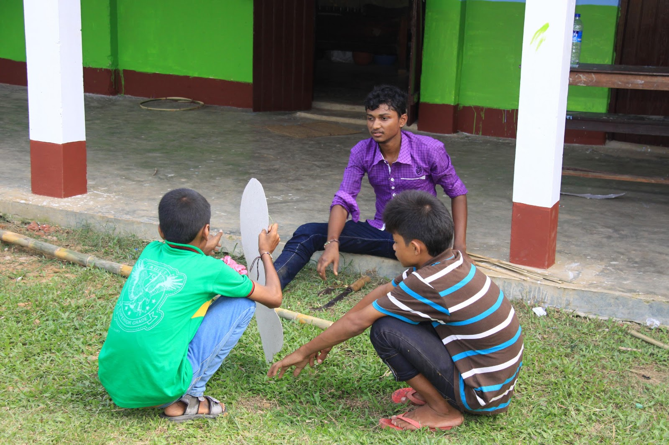
Critical Thinking
Analyzing information and experiences in an objective manner
Recognizing the factors that influence attitudes and behavior
© Miracle Foundation 2020

Slide 13
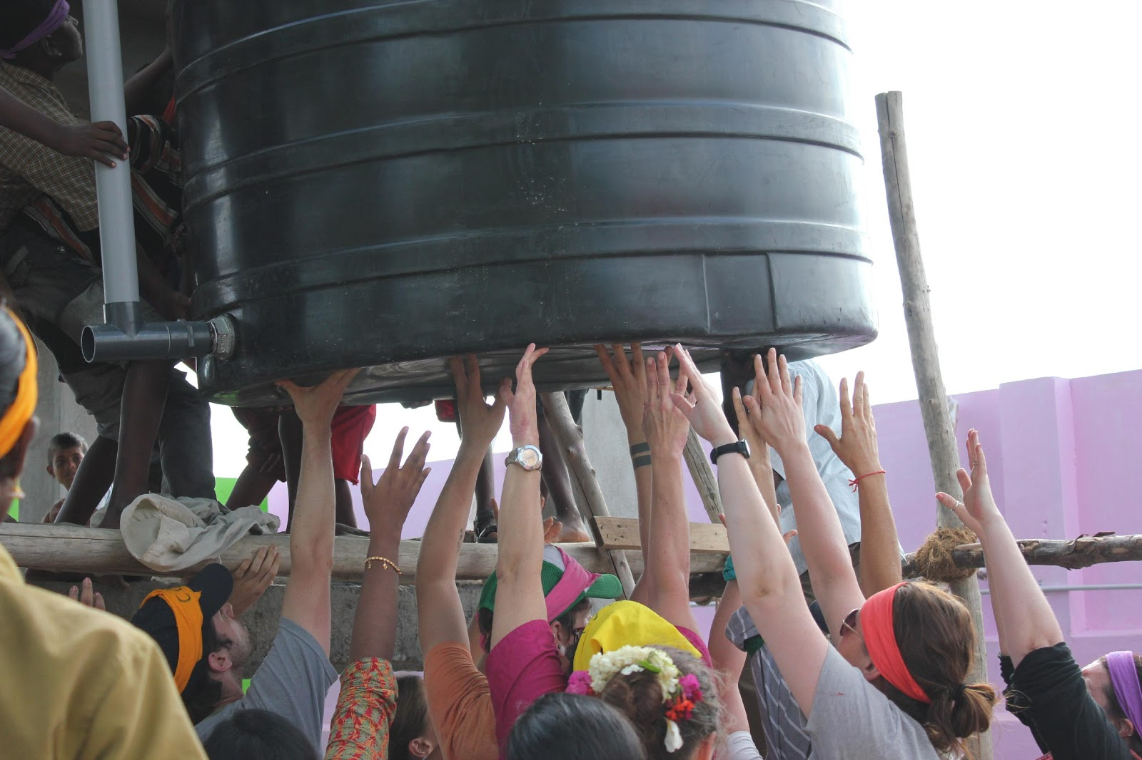
Creative Thinking
Looking beyond the ordinary or usual to think of new ideas
Responding with flexibility – changing your ideas easily when necessary or helpful
© Miracle Foundation 2020

Slide 14
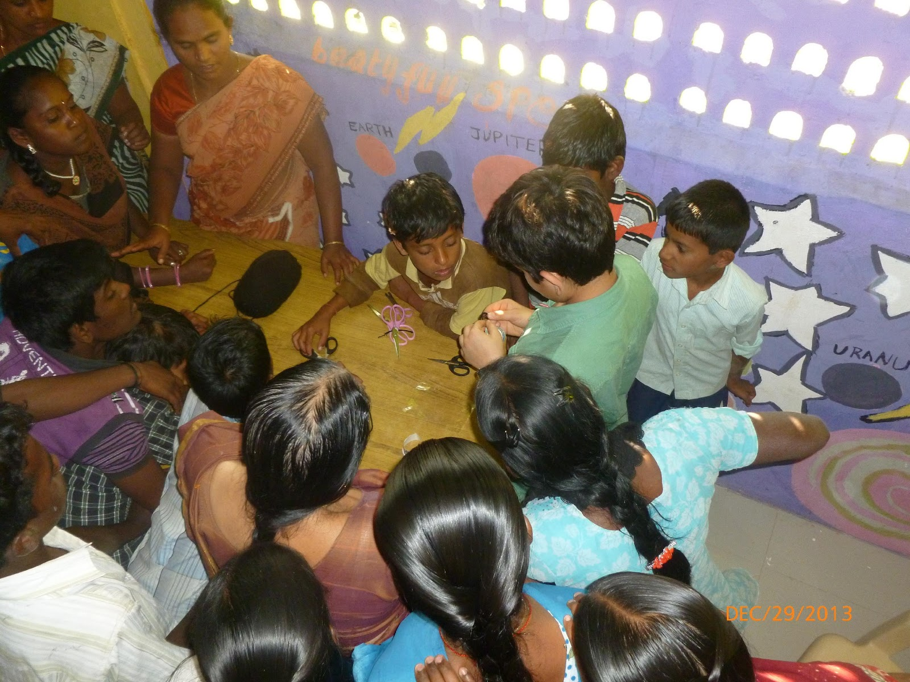
Problem Solving
Working through the details of a problem to reach a solution
Following the steps of gathering information, defining the problem, and considering alternatives
© Miracle Foundation 2020

Slide 15
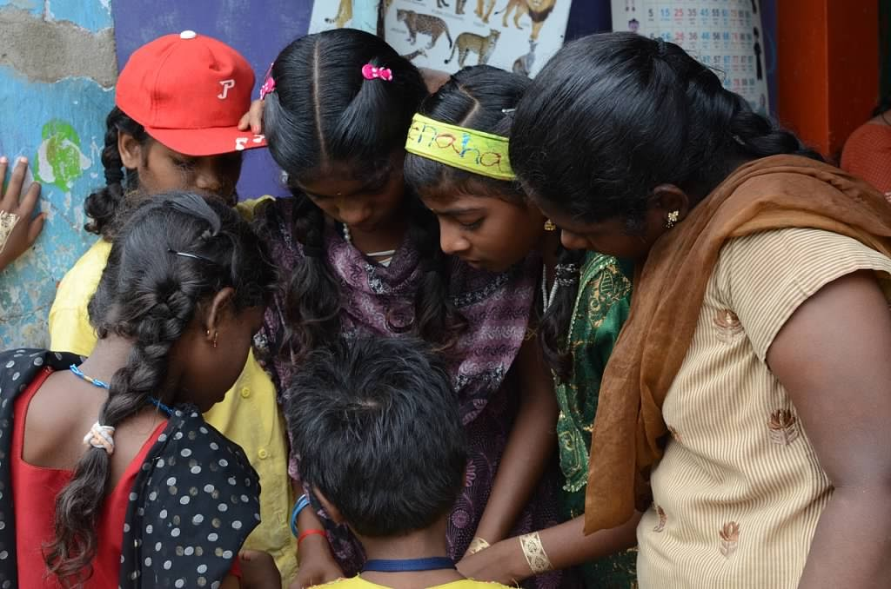
Decision Making
Choosing from a set of alternatives to determine a course of action
Weighing the risks of each option to make a choice
© Miracle Foundation 2020

Slide 16
Emotional Skills
Coping with Emotions
Coping with Stress
© Miracle Foundation 2020

Slide 17
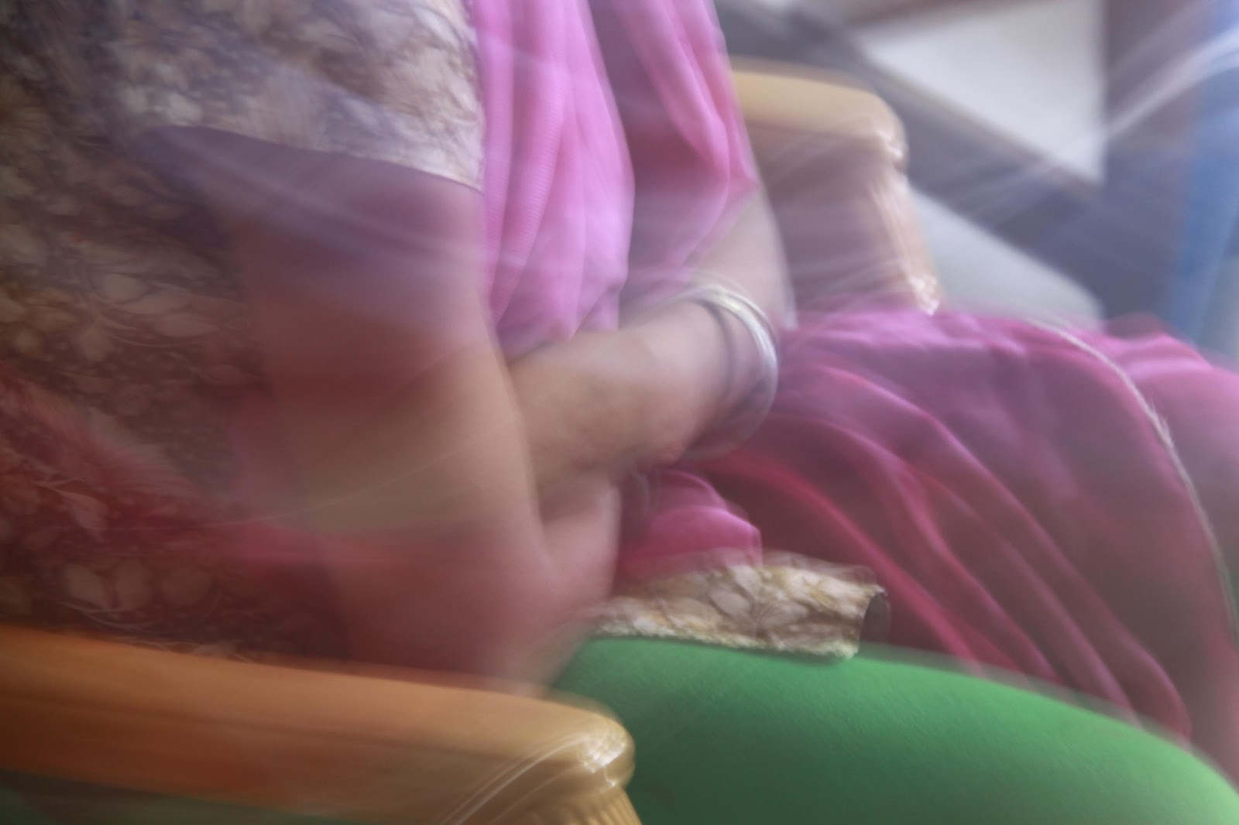
Coping with Emotions
Recognizing emotions within you and others
Being aware of how emotions influence behavior
Responding to your emotions appropriately
© Miracle Foundation 2020

Slide 18
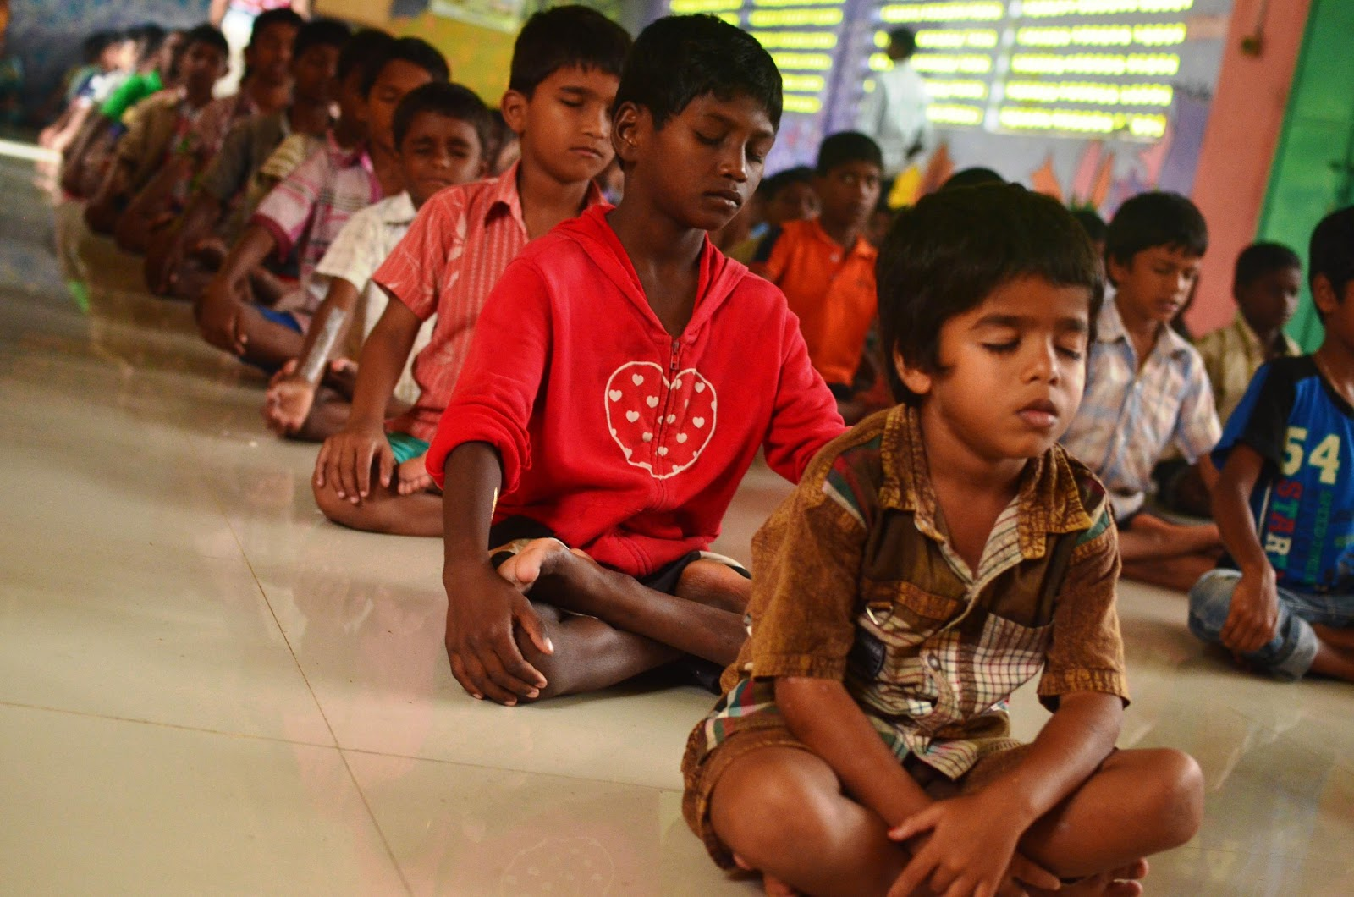
Coping with Stress
Recognizing the sources of stress in your life and how stress affects you
Learning ways to control levels of stress
© Miracle Foundation 2020

Slide 19
Thank you!
© Miracle Foundation 2020

