Slide 1
Life Skills
© Miracle Foundation 2020

Slide 2
© Miracle Foundation 2020

Slide 3
© Miracle Foundation 2020

Slide 4
© Miracle Foundation 2020

Slide 5
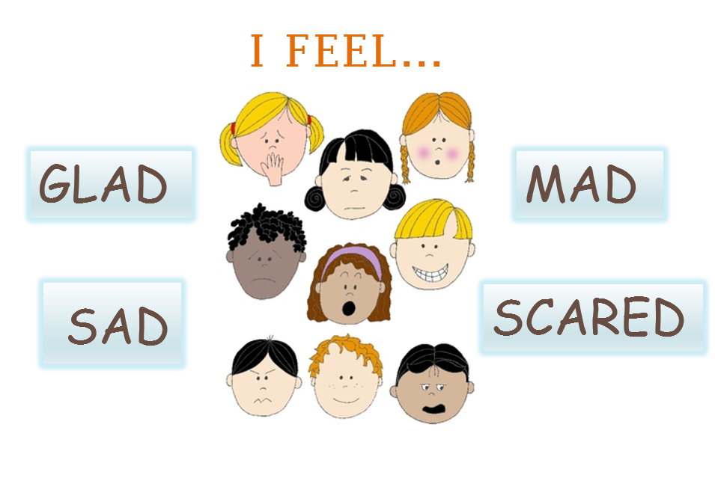
© Miracle Foundation 2020

Slide 6
© Miracle Foundation 2020

Slide 7
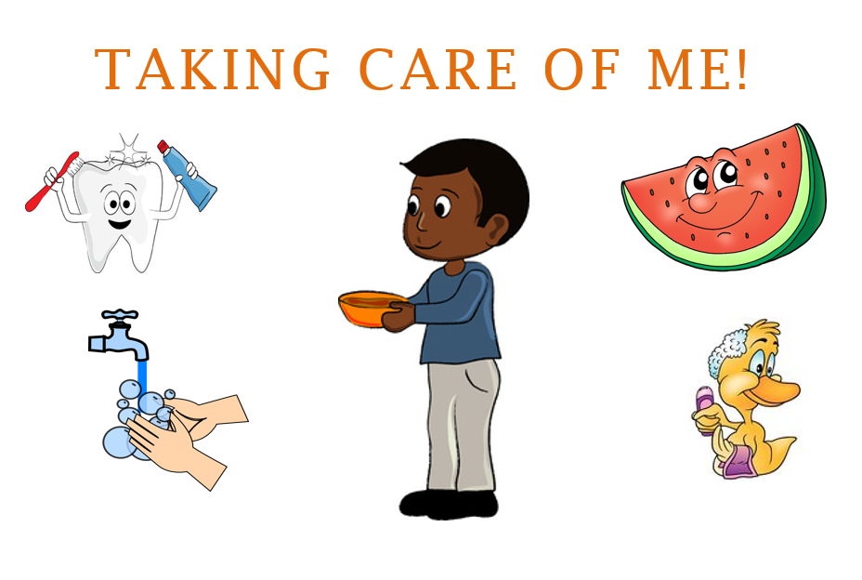
© Miracle Foundation 2020

Slide 8
© Miracle Foundation 2020

Slide 9
© Miracle Foundation 2020

Slide 10
Thank you!
© Miracle Foundation 2020

