Slide 1
Introduction to Life Skills
Ages 9-12
© Miracle Foundation 2020

Slide 2
What are Life Skills?
© Miracle Foundation 2020

Slide 3
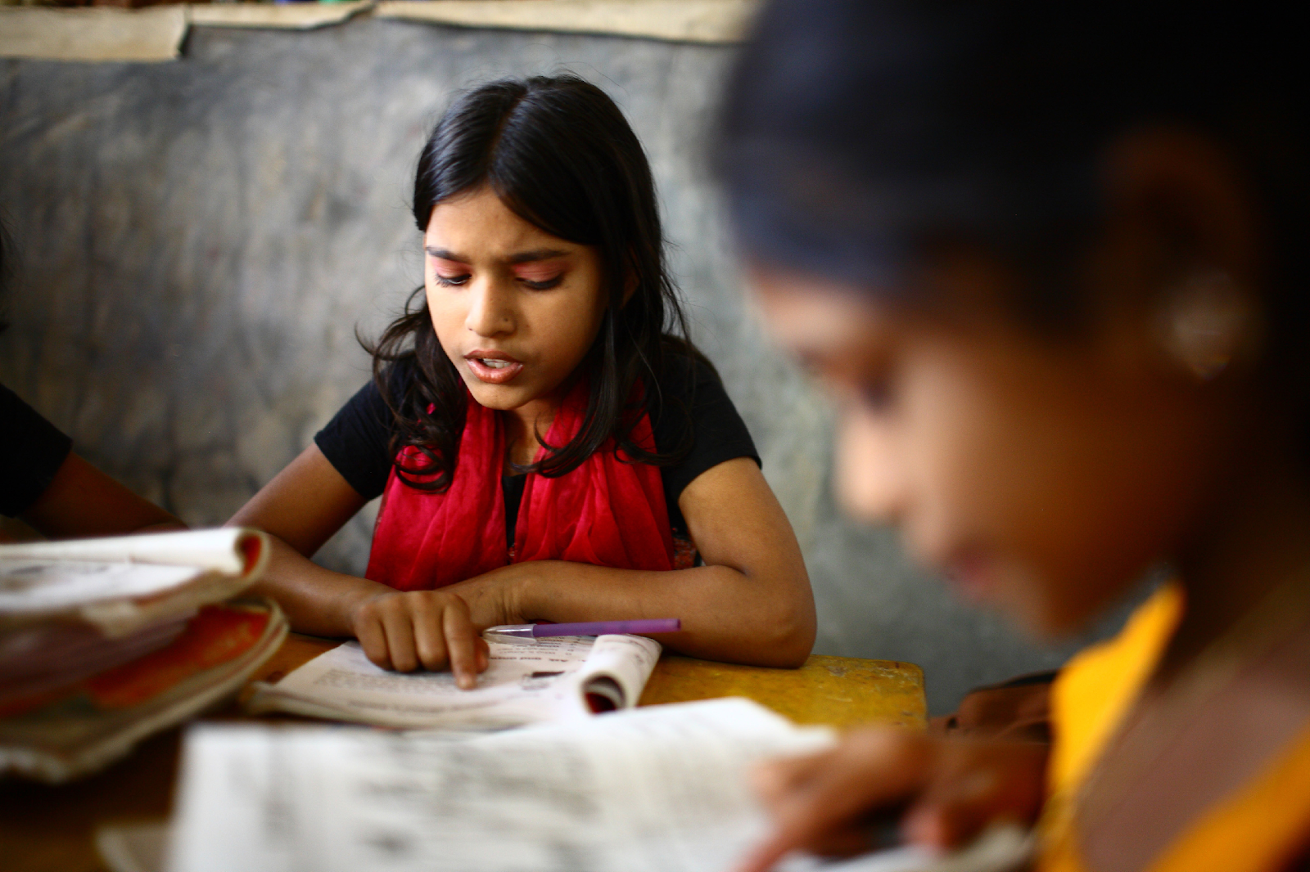
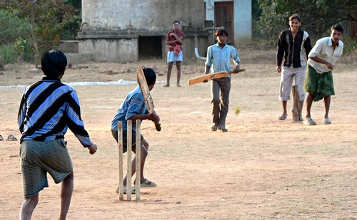
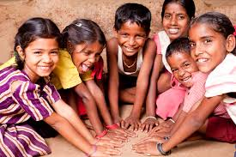
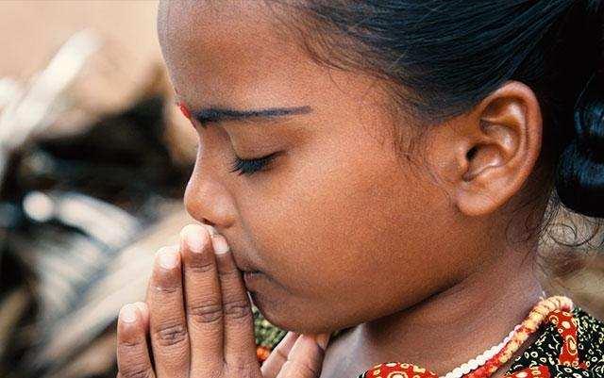
Who am I? What is important to me?
© Miracle Foundation 2020

Slide 4
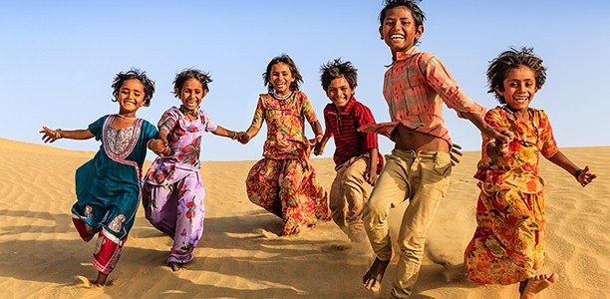
Getting along with others
© Miracle Foundation 2020

Slide 5
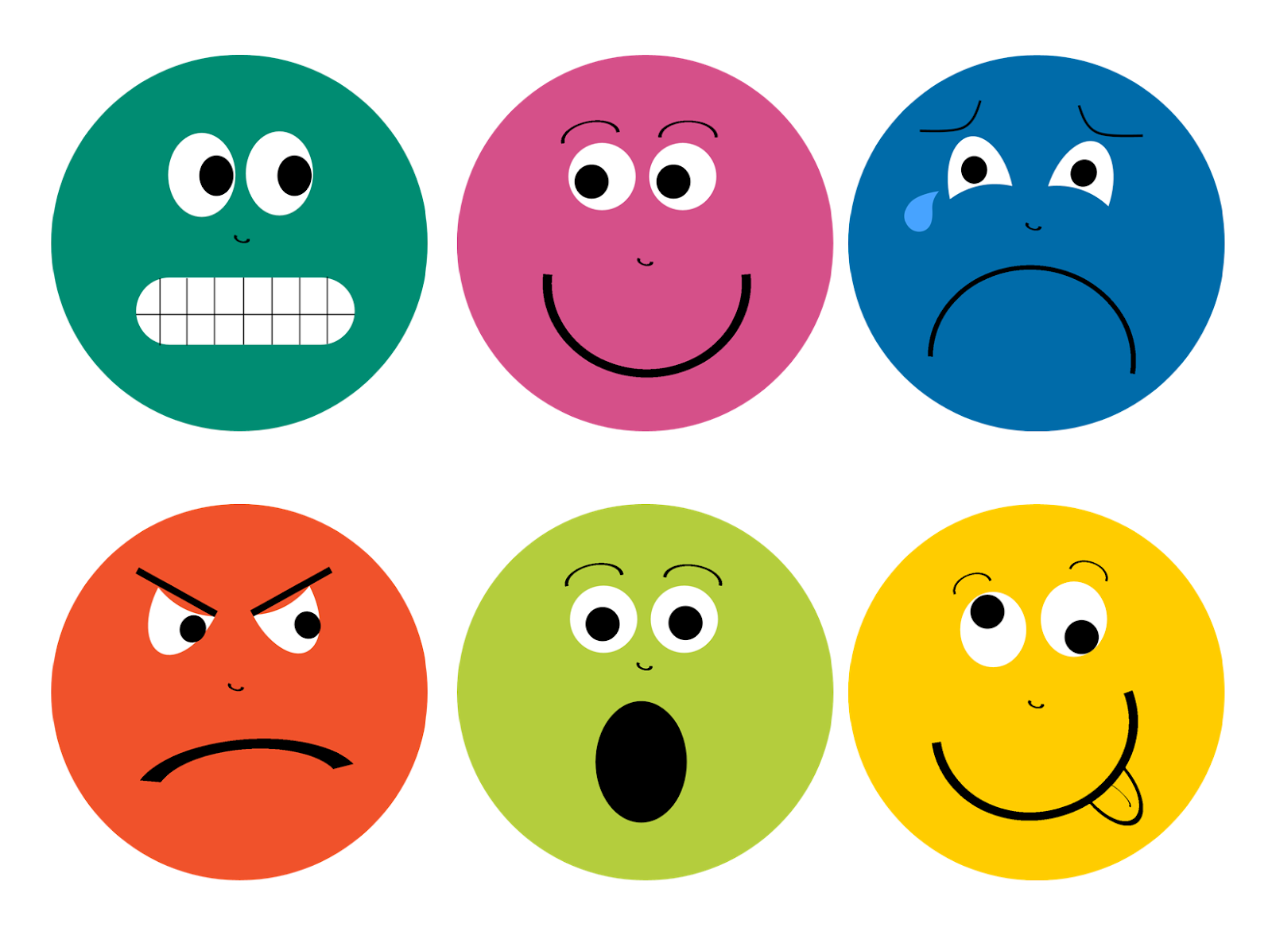
Expressing your feelings
© Miracle Foundation 2020

Slide 6
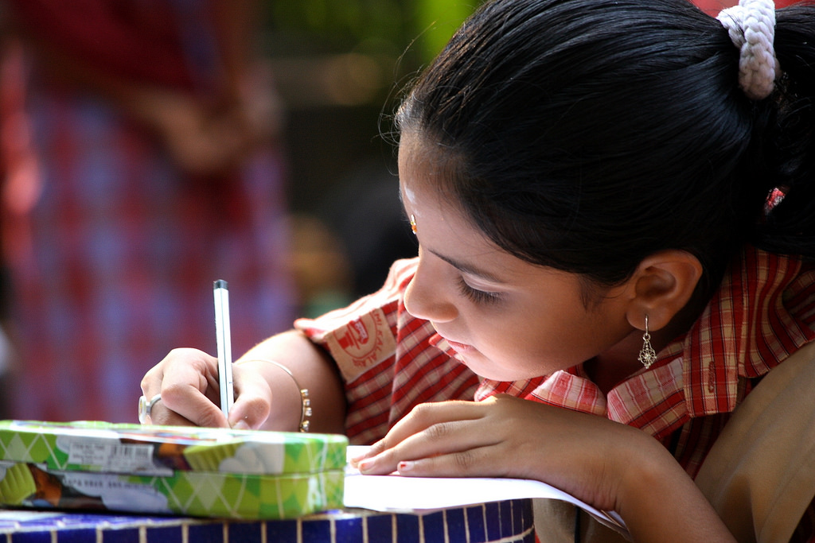
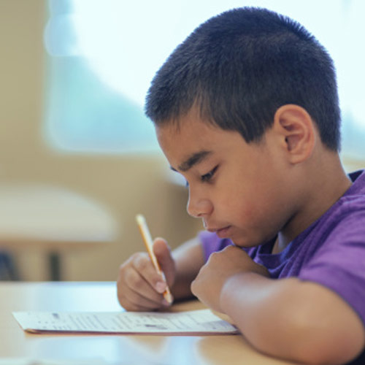
Thinking and Studying
© Miracle Foundation 2020

Slide 7
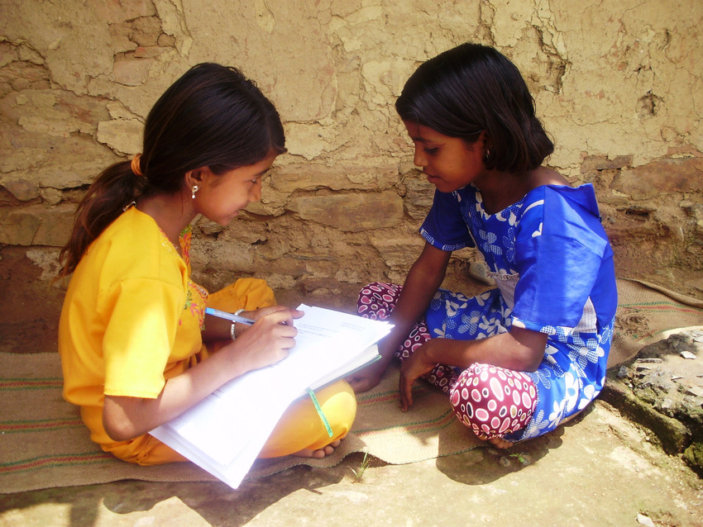
Listening and Talking
© Miracle Foundation 2020

Slide 8
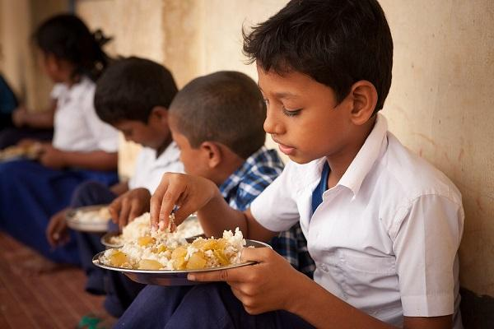
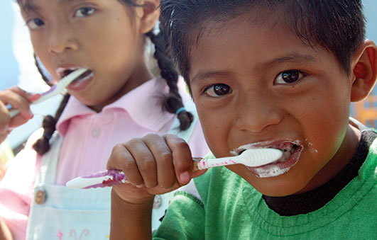
Taking Care of Myself
© Miracle Foundation 2020

Slide 9
Thank you!
© Miracle Foundation 2020

