Slide 1
Miracle Foundation Rights of the Child
Ages 13+
© Miracle Foundation 2020

Slide 2
Supporting orphans to have a better quality of life while bringing about sustainable change that reduces the need for orphanages
Our Mission
© Miracle Foundation 2020

Slide 3
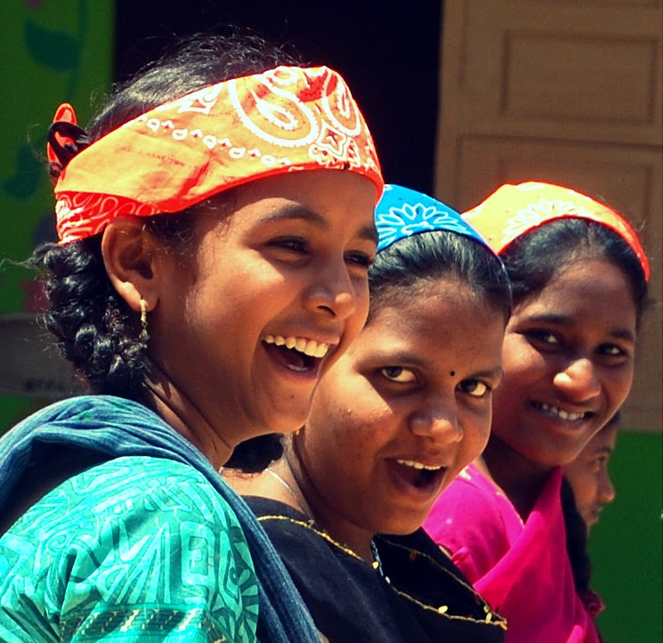
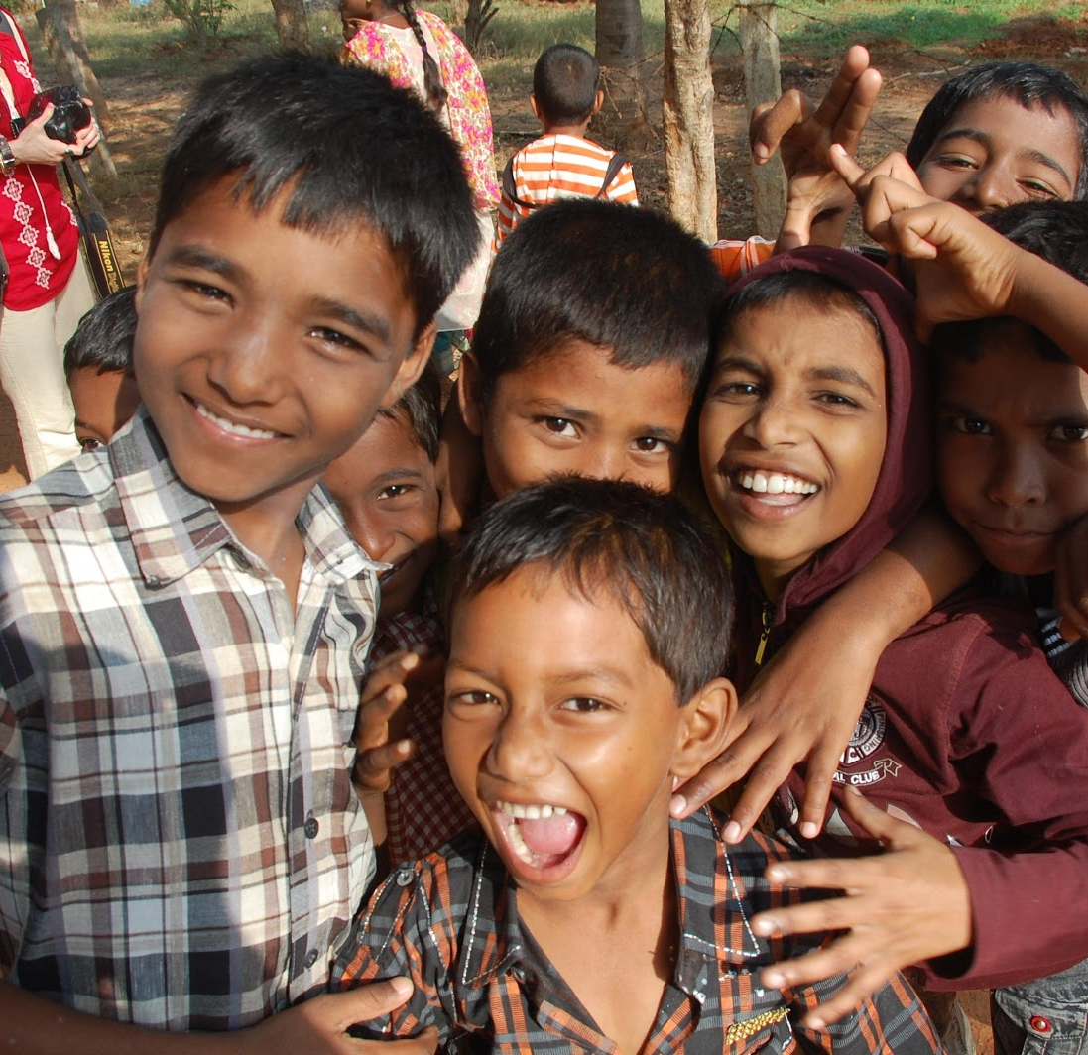
We Believe that All Children Have Basic Rights
All People Deserve These Rights!
© Miracle Foundation 2020

Slide 4
Rights of the Child
The following are a few of the rights based on documents produced by the United Nations in 1989.
© Miracle Foundation 2020

Slide 5
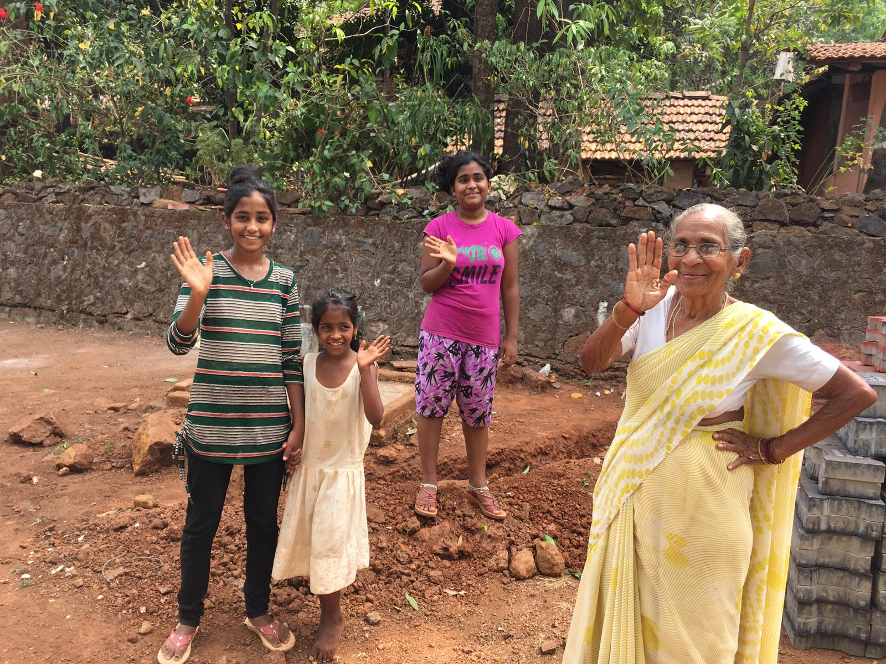
The Right to Live in a Family or Family Environment
Every child lives in a family, either with their parents, extended family, foster family, an adoptive home or in a family-style environment where they have a sense of belonging.
© Miracle Foundation 2020

Slide 6
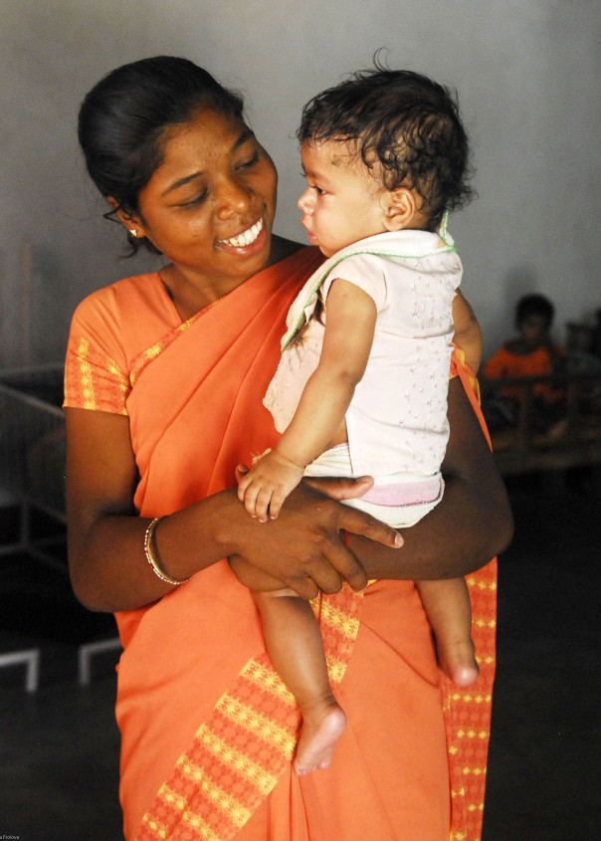
The Right to a Stable, Loving, and Nurturing Environment
Every child is provided a stable, loving, and nurturing family environment.
© Miracle Foundation 2020

Slide 7
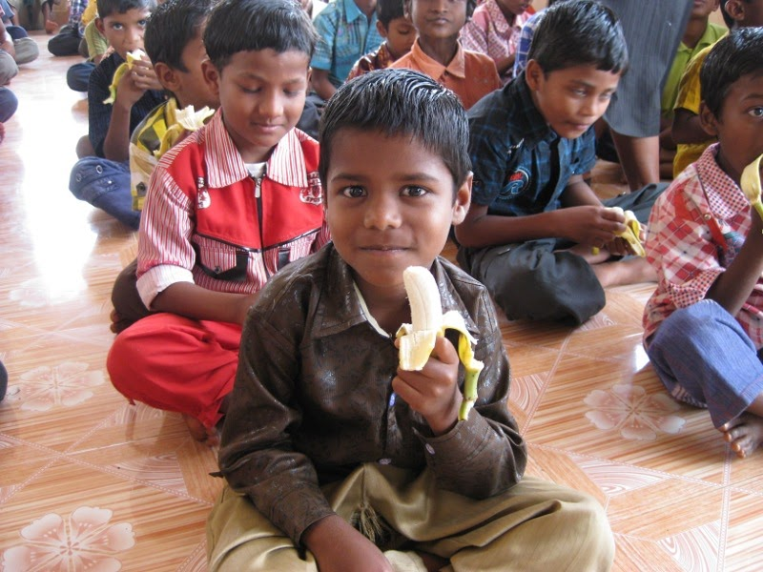
The Right to Healthcare and Nutrition
Every child receives regular, high-quality medical attention, is taught good health and hygiene habits, and is provided nutritious, delicious food at every meal.
© Miracle Foundation 2020

Slide 8
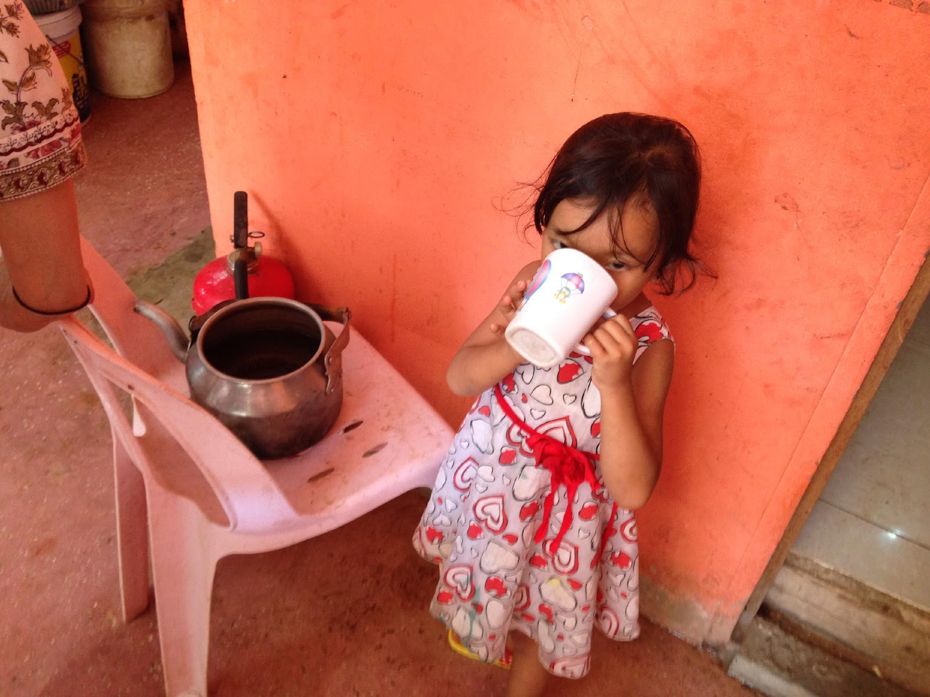
The Right to Clean Water and Electrical Power
Every child receives consistent access to clean water and electrical power.
© Miracle Foundation 2020

Slide 9
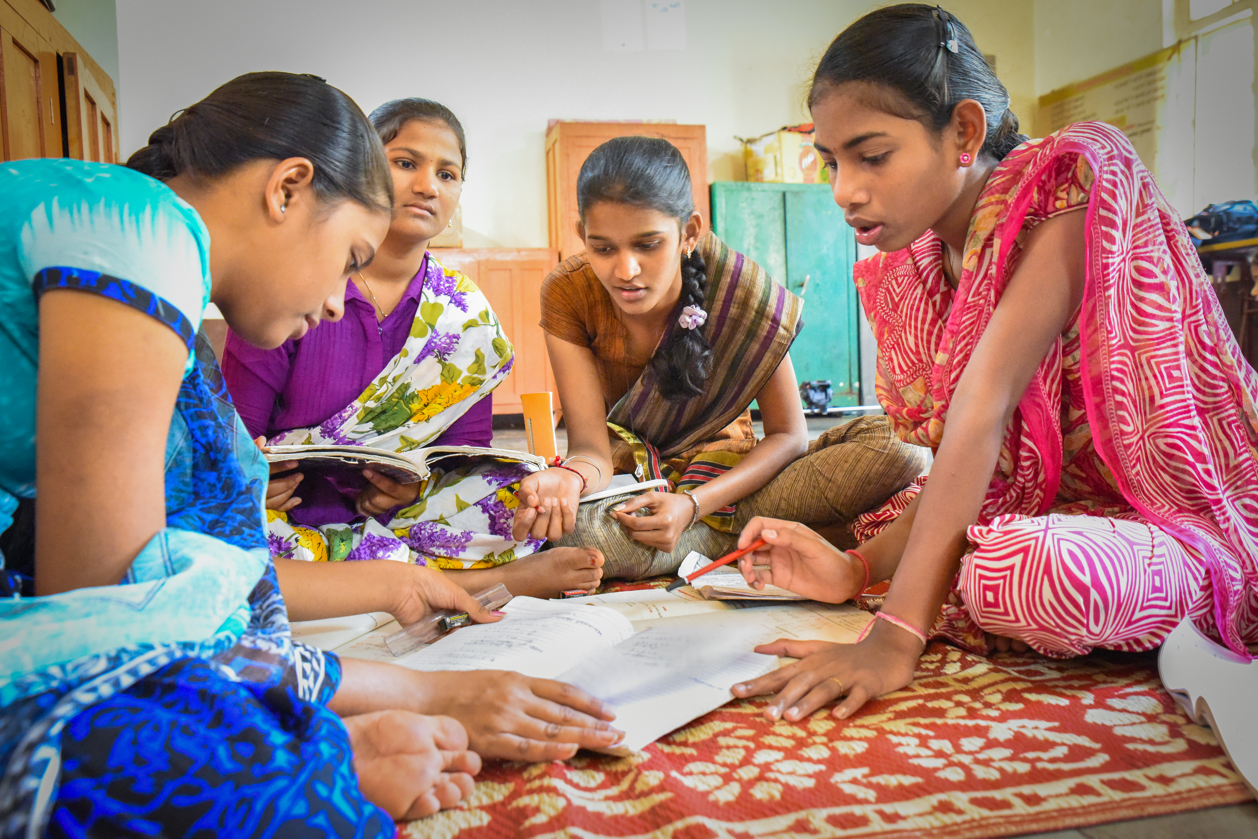
The Right to Quality Education
Every child receives a quality education, enrichment programs, and access to higher education and/or vocational training.
© Miracle Foundation 2020

Slide 10
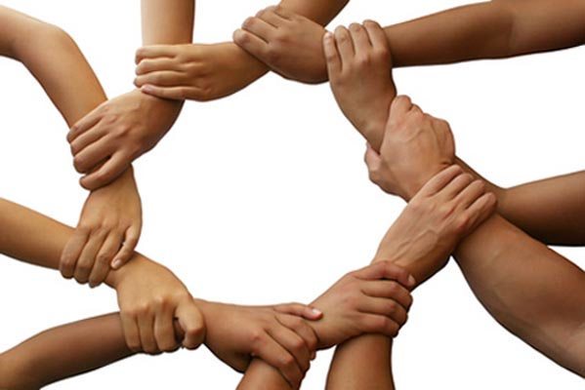
The Right to Equal Opportunity
© Miracle Foundation 2020

Slide 11
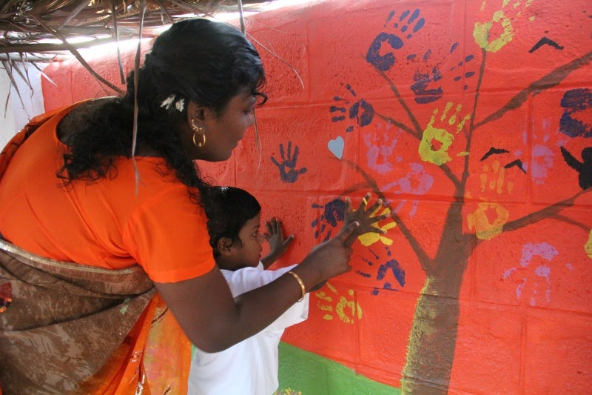
The Right to Guidance
Every child is actively supported by caring adults who are invested in the child’s success.
© Miracle Foundation 2020

Slide 12
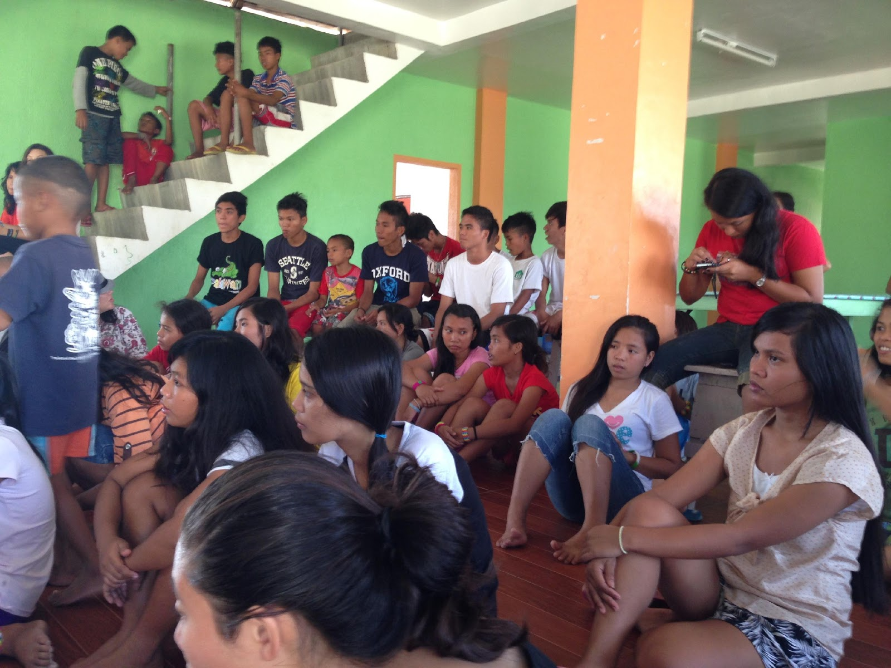
The Right to Be Heard and Participate
Every child has the right to express their views freely in all matters affecting them. They are encouraged to develop and express independent thought.
© Miracle Foundation 2020

Slide 13
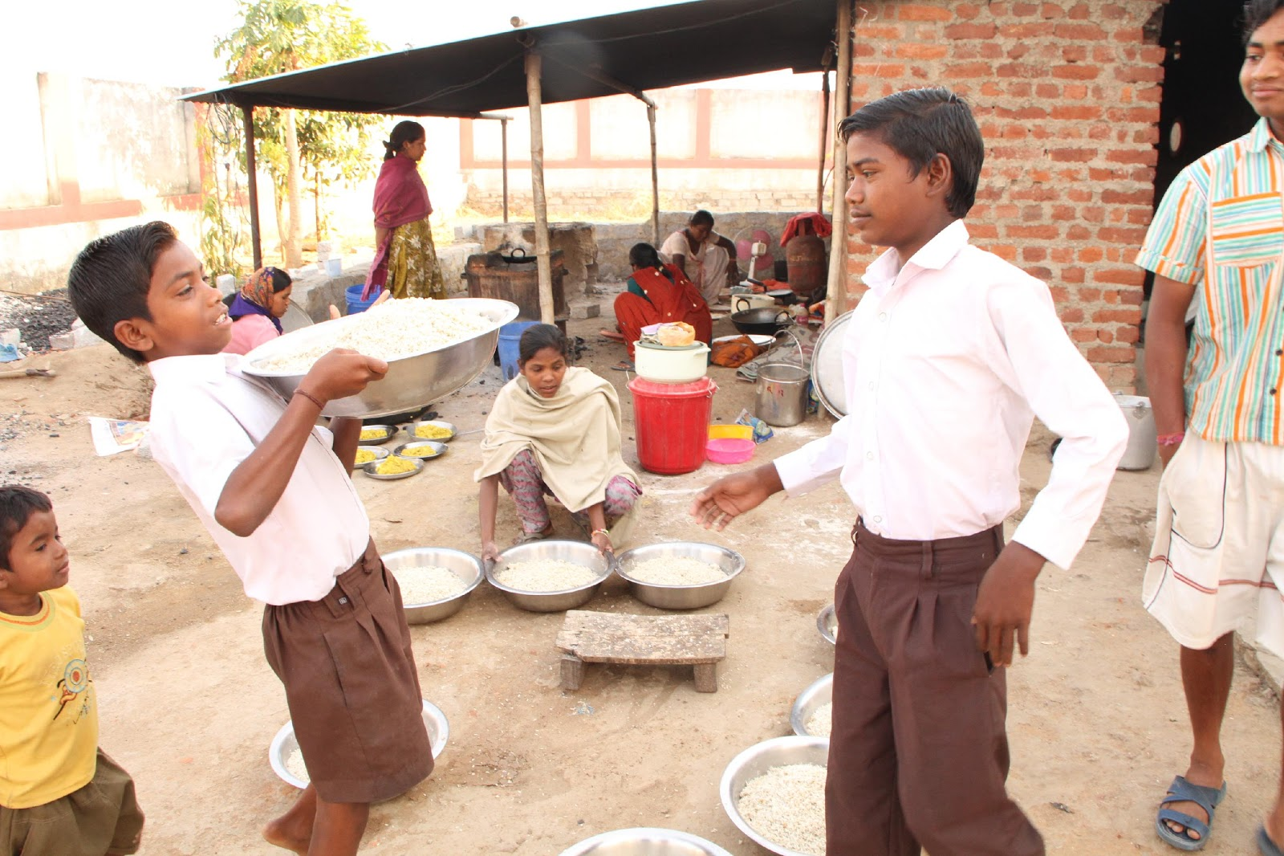
The Right to Be Prepared for Active and Responsible Citizenship
Every child is taught responsibility, a sense of community, and the importance of service.
© Miracle Foundation 2020

Slide 14
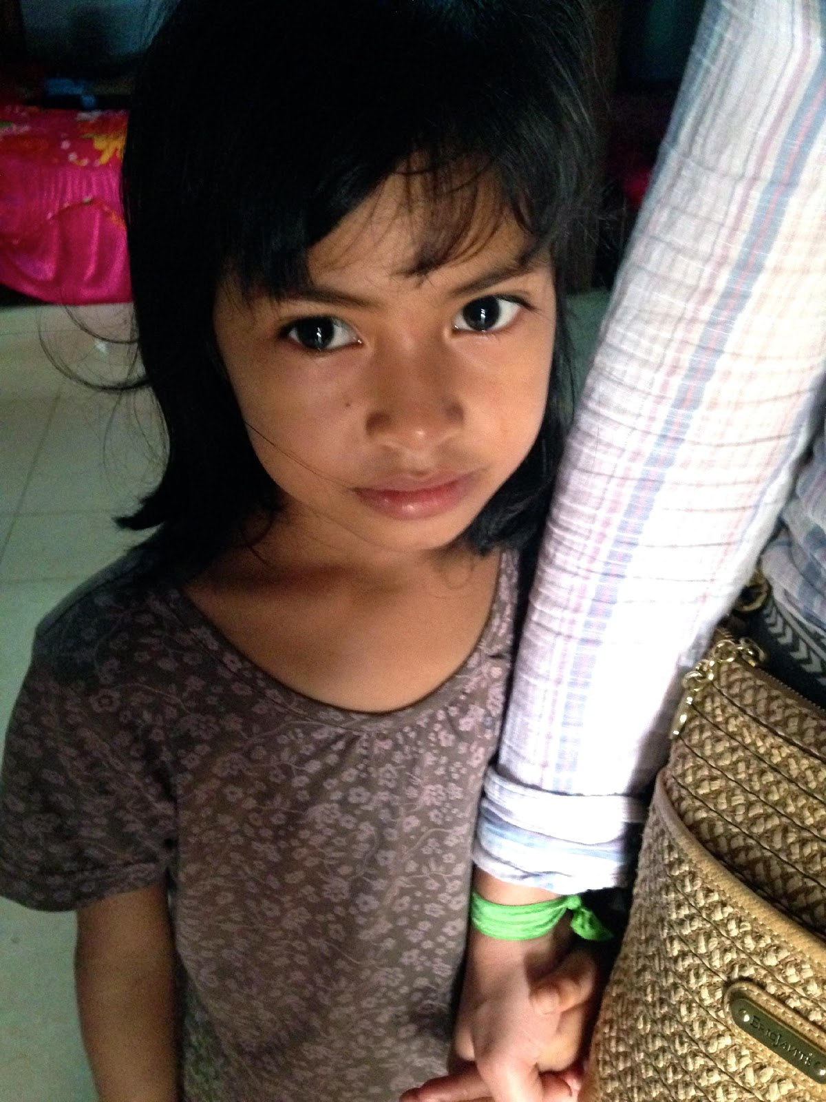
The Right to Be Protected from Abuse and Neglect
Every child is protected from abuse, neglect, corporal punishment and all forms of exploitation.
© Miracle Foundation 2020

Slide 15
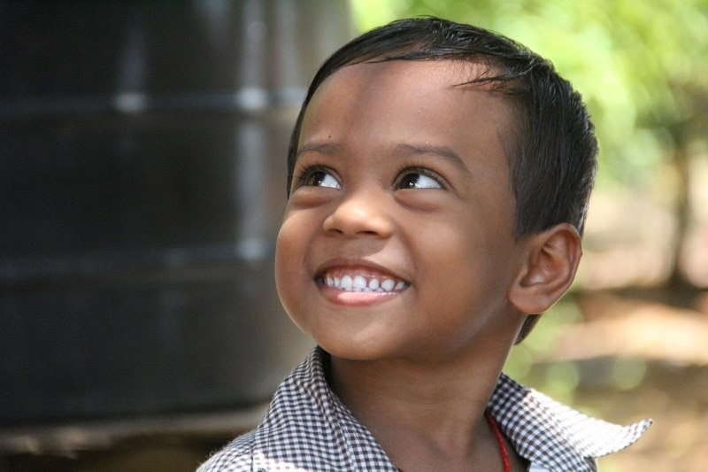
The Right to Dignity and Freedom
Every child is treated with respect and lives in adequate conditions with sufficient belongings – fostering a sense of dignity and freedom.
© Miracle Foundation 2020

Slide 16
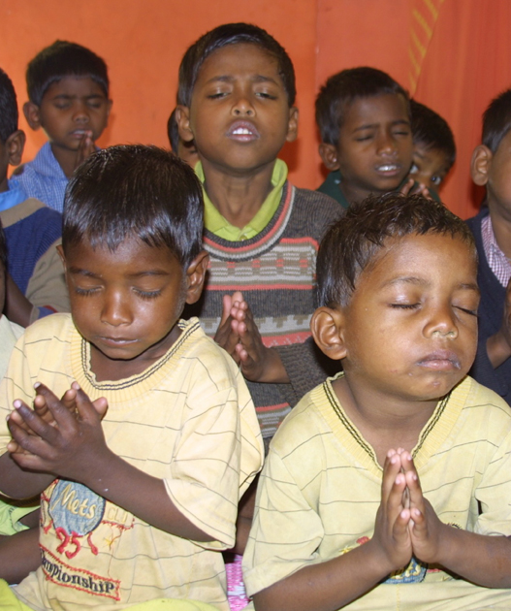
The Right to Spiritual Development
Every child is provided opportunities to develop a religious affiliation that promotes spirituality and moral development.
© Miracle Foundation 2020

Slide 17
Thank you!
© Miracle Foundation 2020

