Slide 1
Study Skills

Slide 2
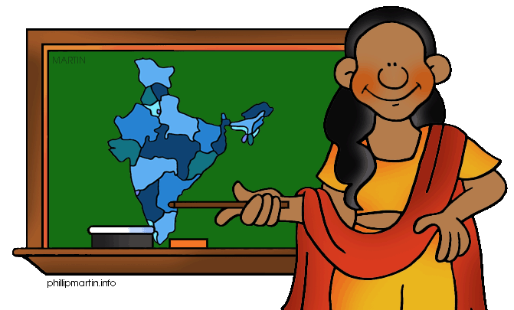
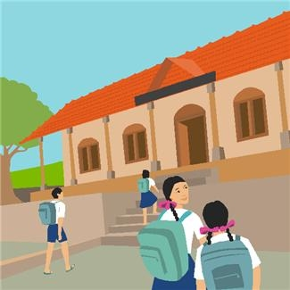
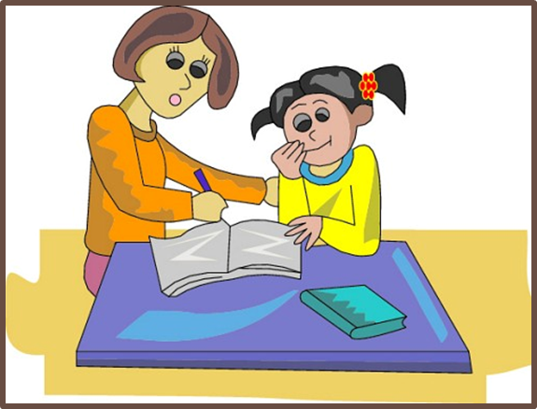
A Day at School
What do you learn in school?
Do you go to school everyday?
Do you come home and do homework?

Slide 3
Before you study

Slide 4

Get Some Rest

Slide 5


Eat a Healthy Snack

Slide 6

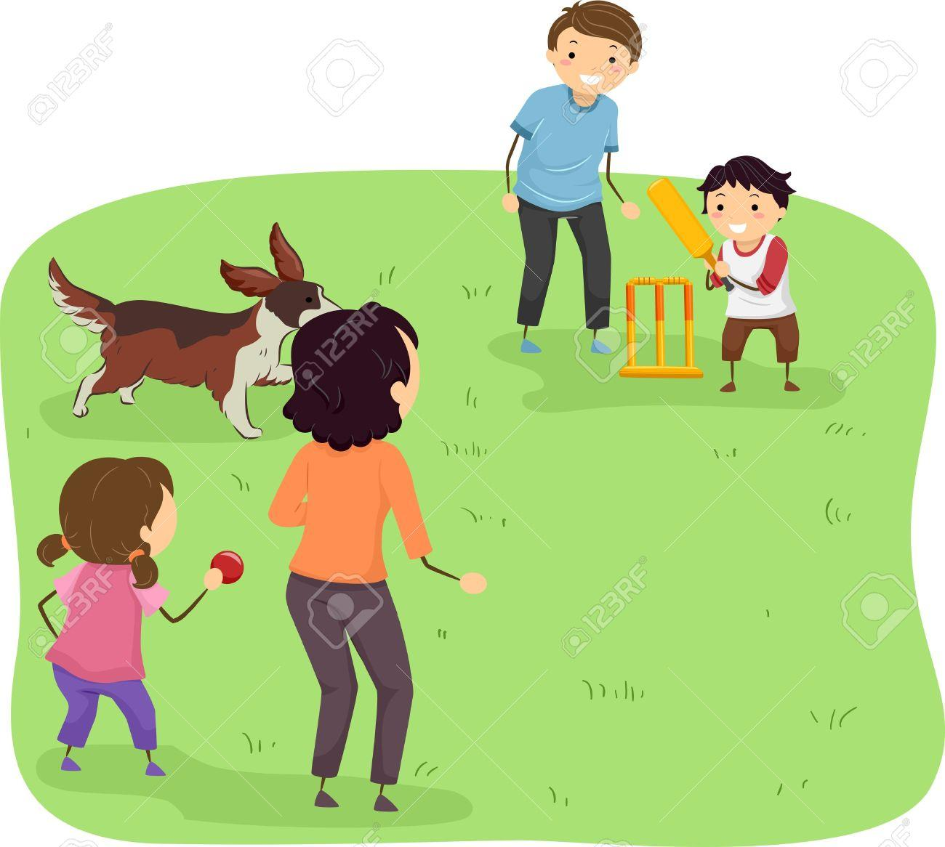
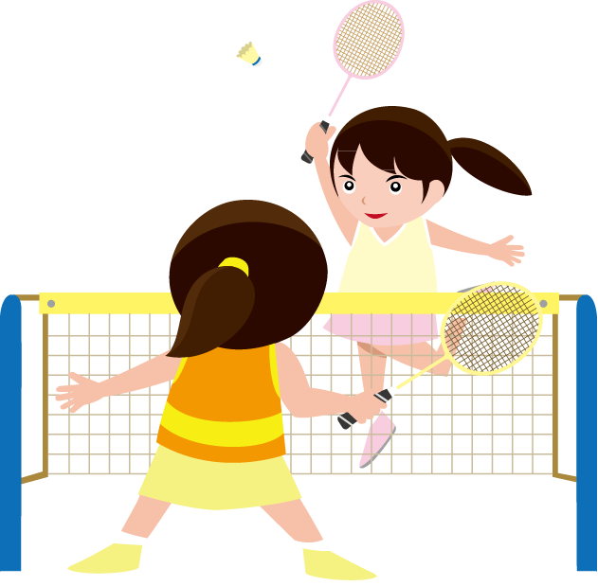
Play

Slide 7
Study Time!

Slide 8


Learning is Fun!

Slide 9
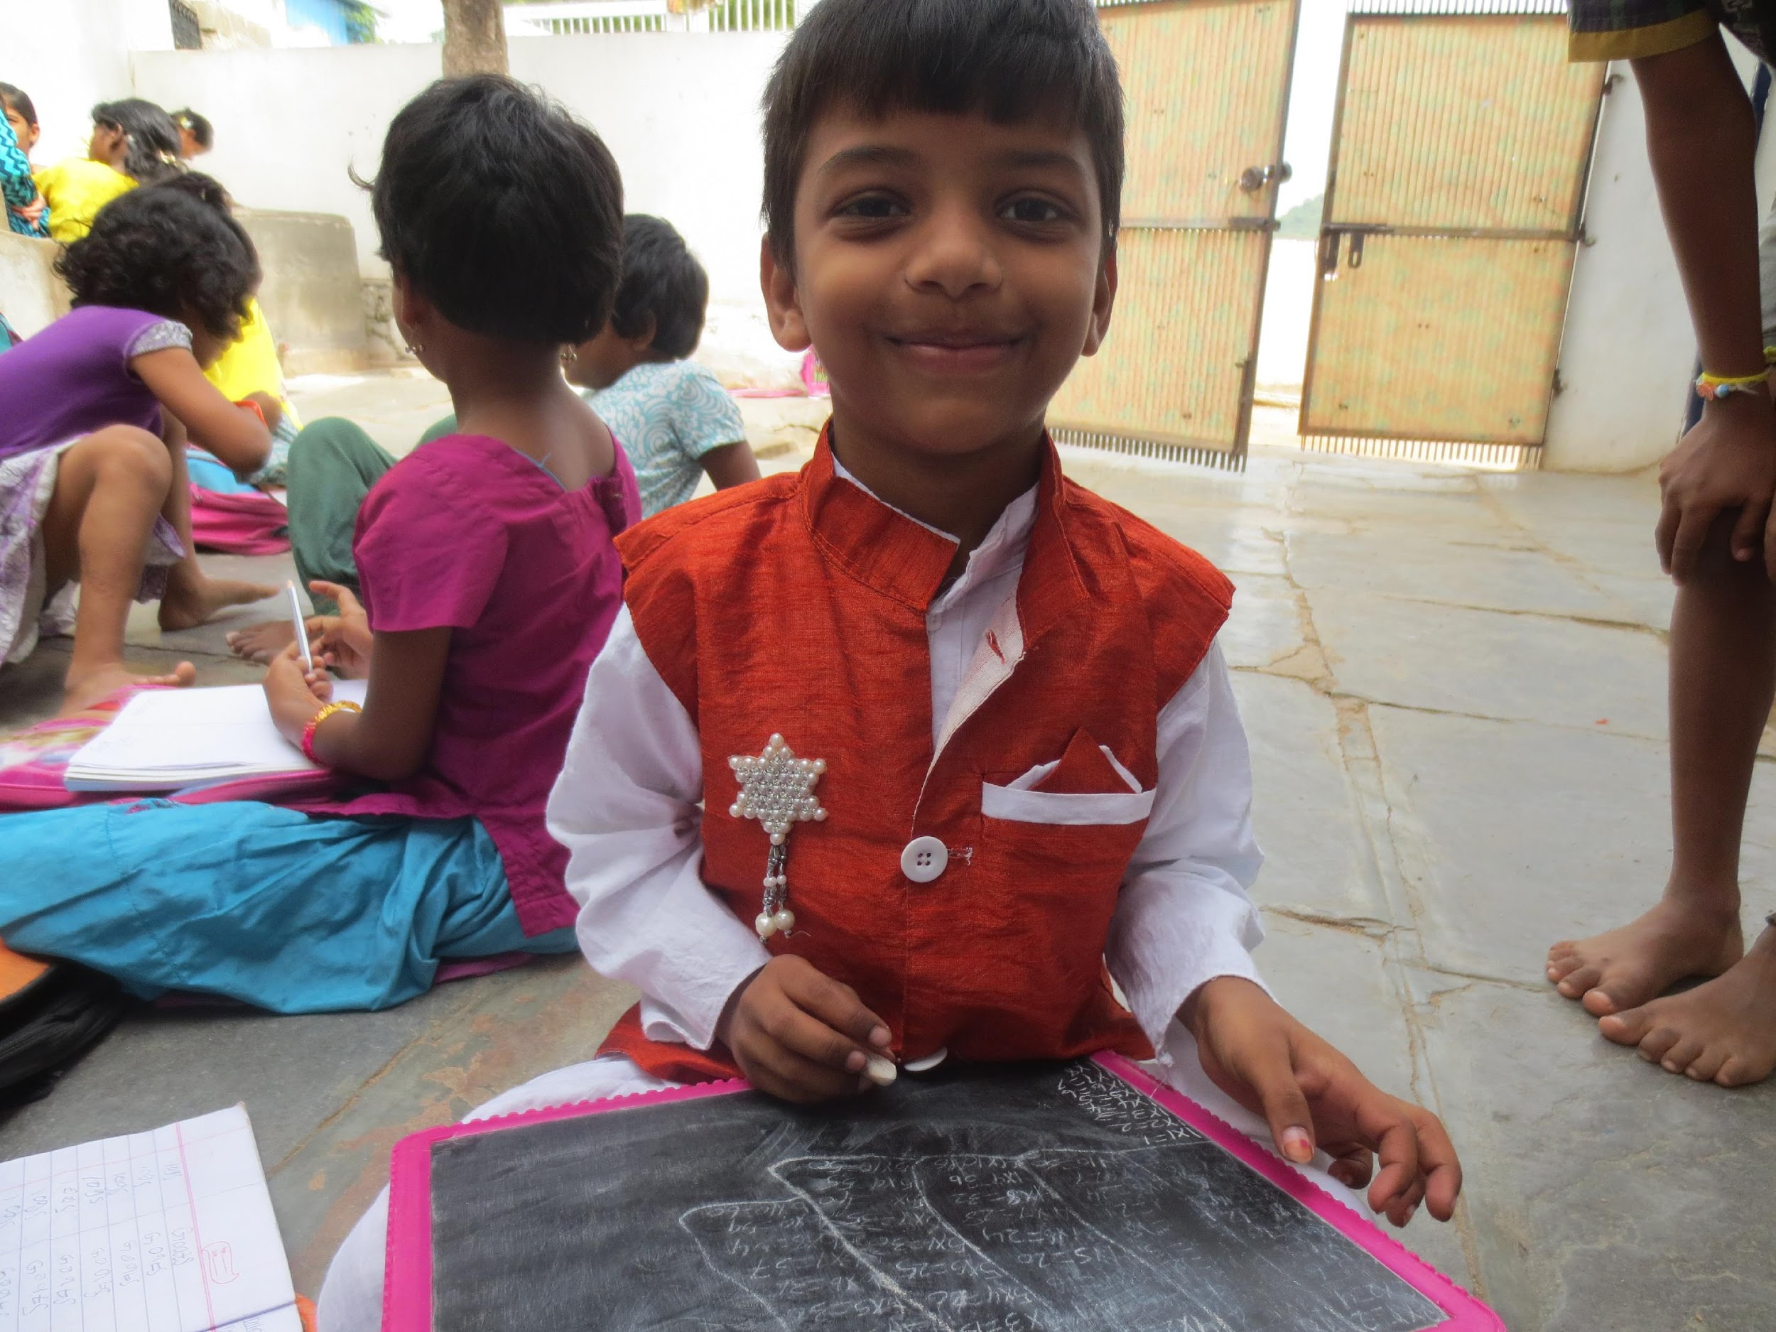
Make Friends with your Homework

Slide 10
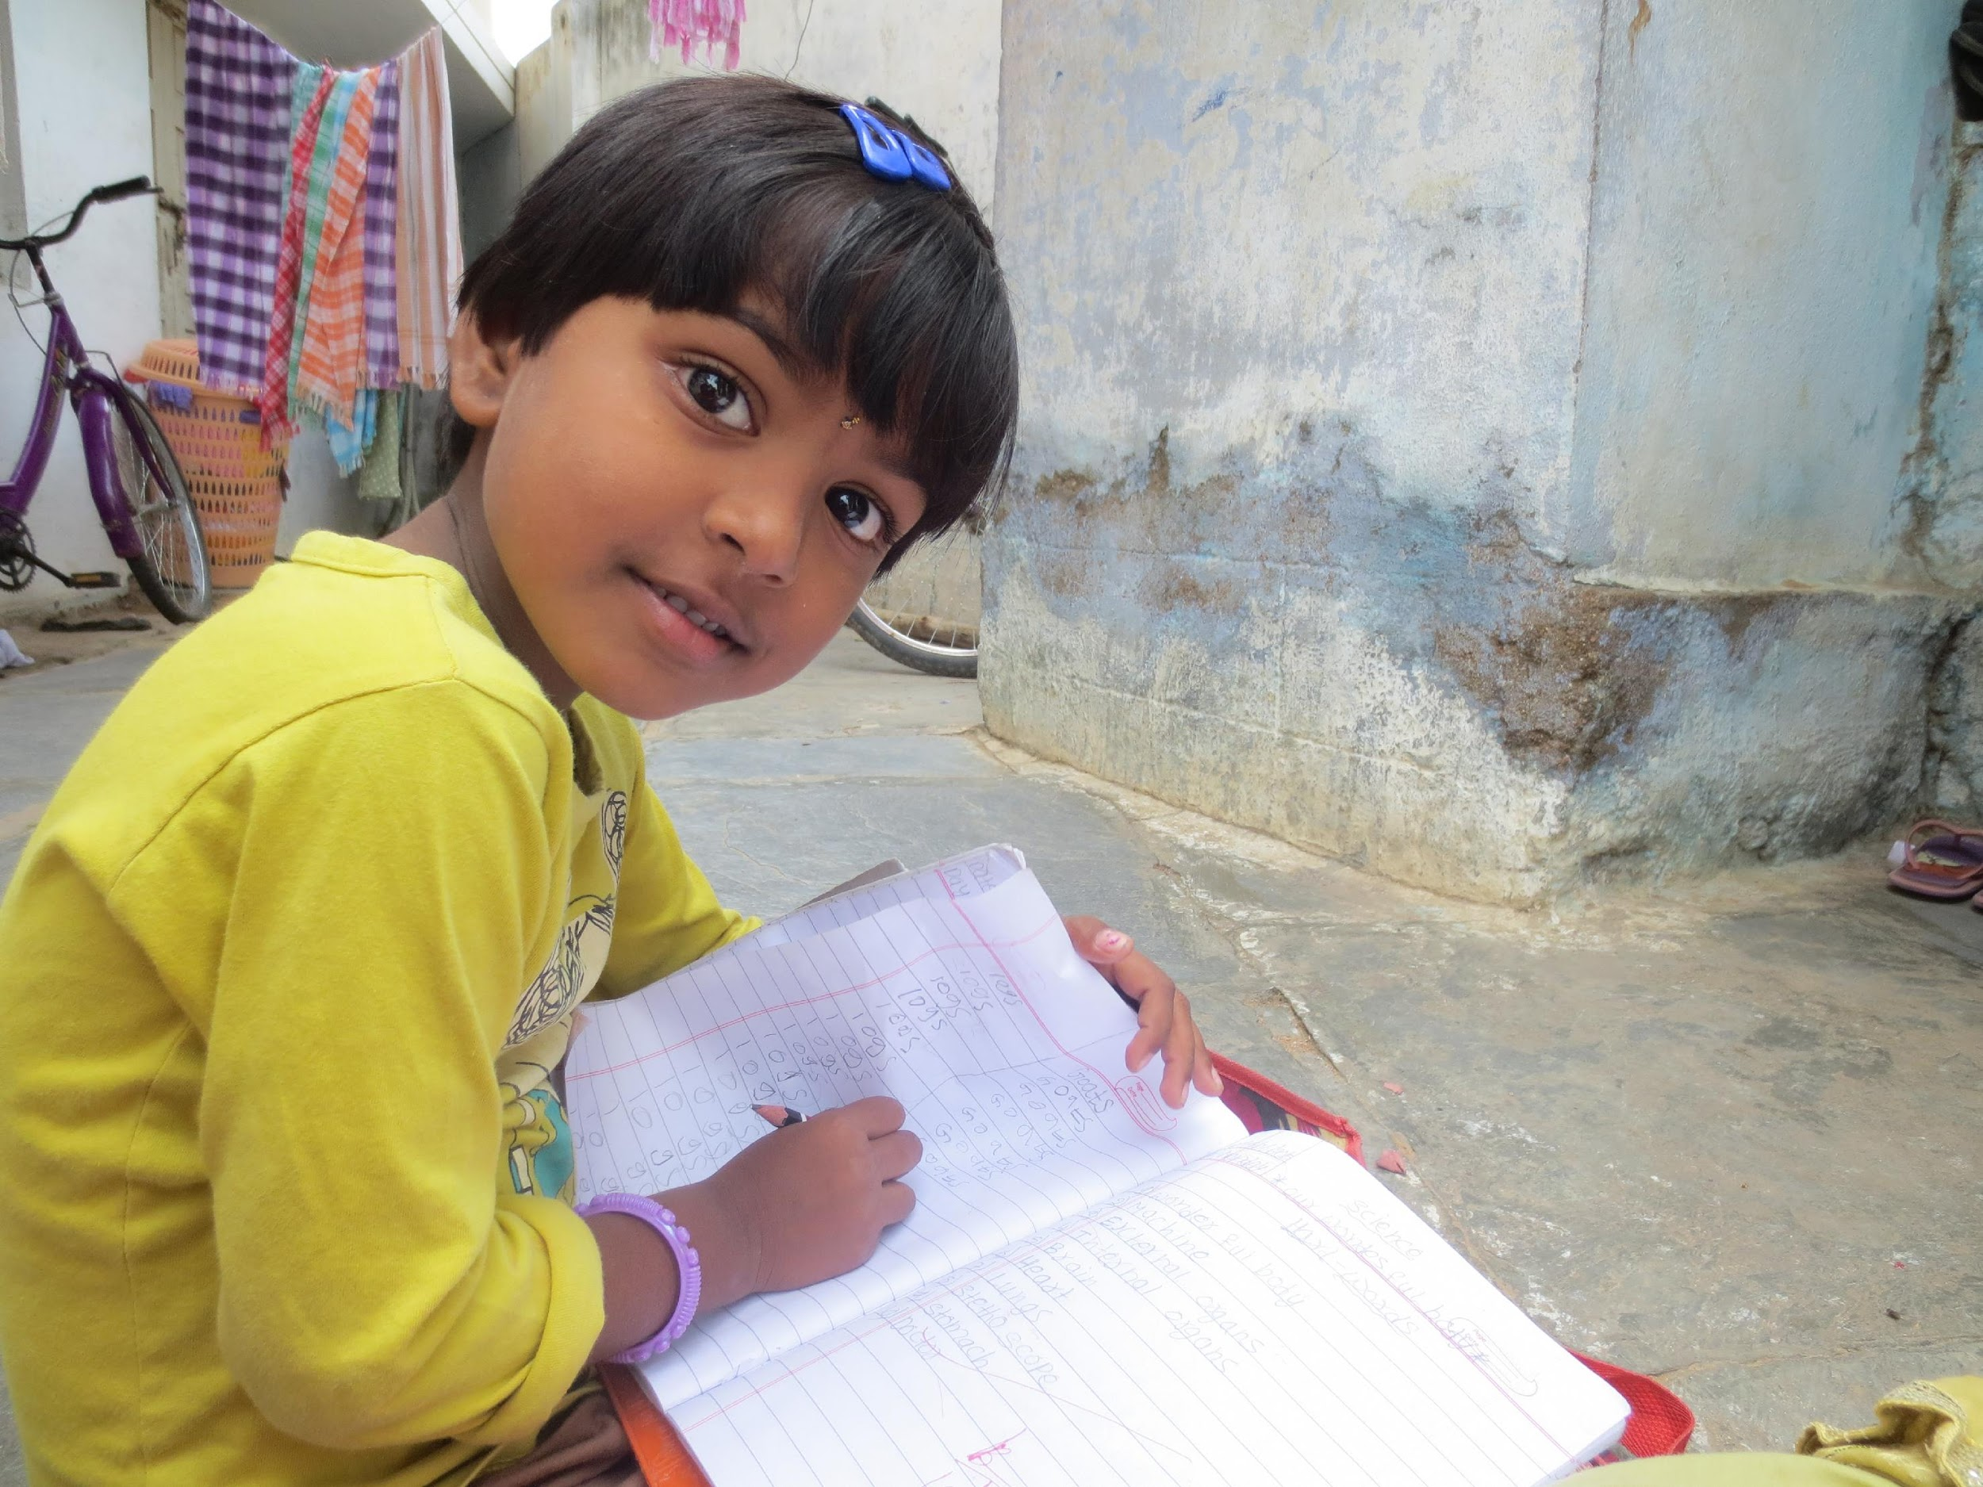
Study in the Same Place Everyday

Slide 11
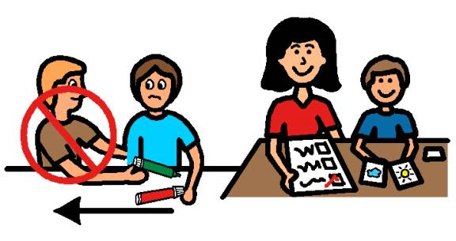
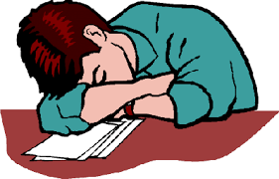
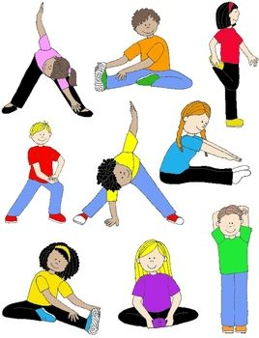

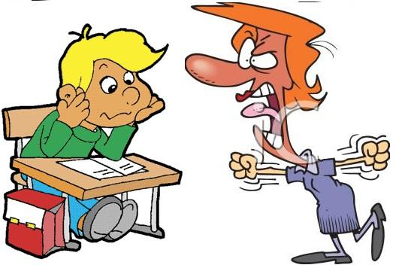
Don’t Disturb Others
Keep your hands to yourselves

