Slide 1
Study Skills
Ages 9-12, 13+
© Miracle Foundation 2020

Slide 2
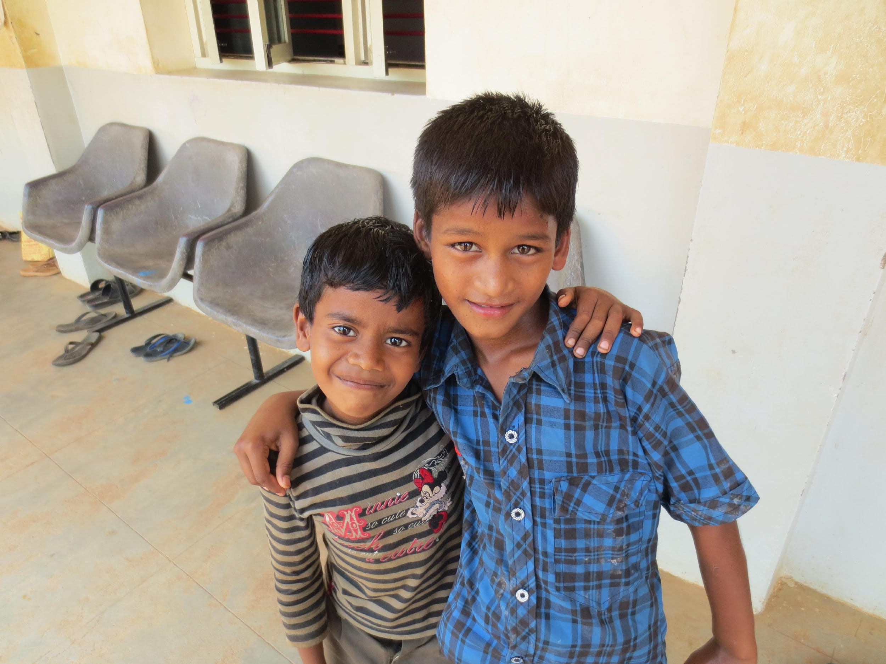
Motivating Yourself to Study
© Miracle Foundation 2020

Slide 3
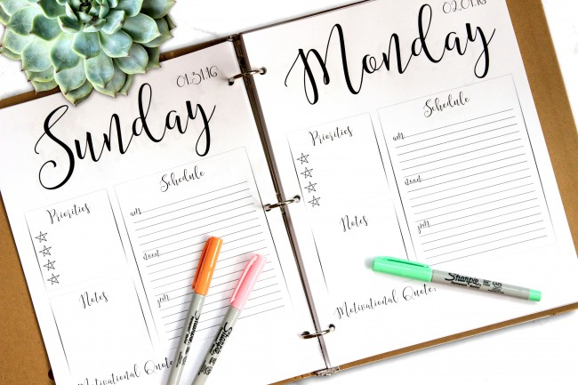
SMART Academic Goals
© Miracle Foundation 2020

Slide 4
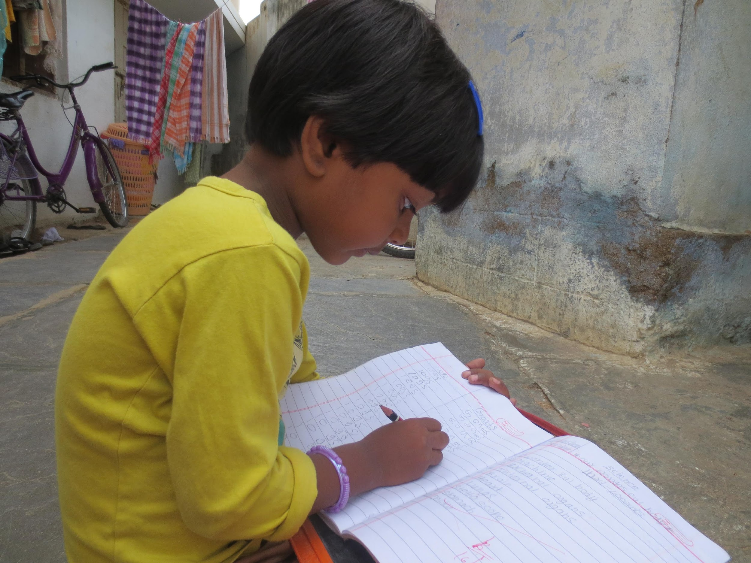
Start Easy or Start Hard
© Miracle Foundation 2020

Slide 5
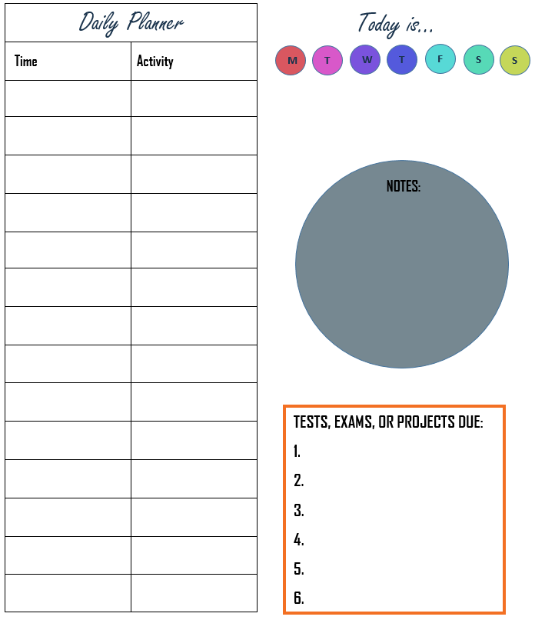
Measure your Progress
© Miracle Foundation 2020

Slide 6
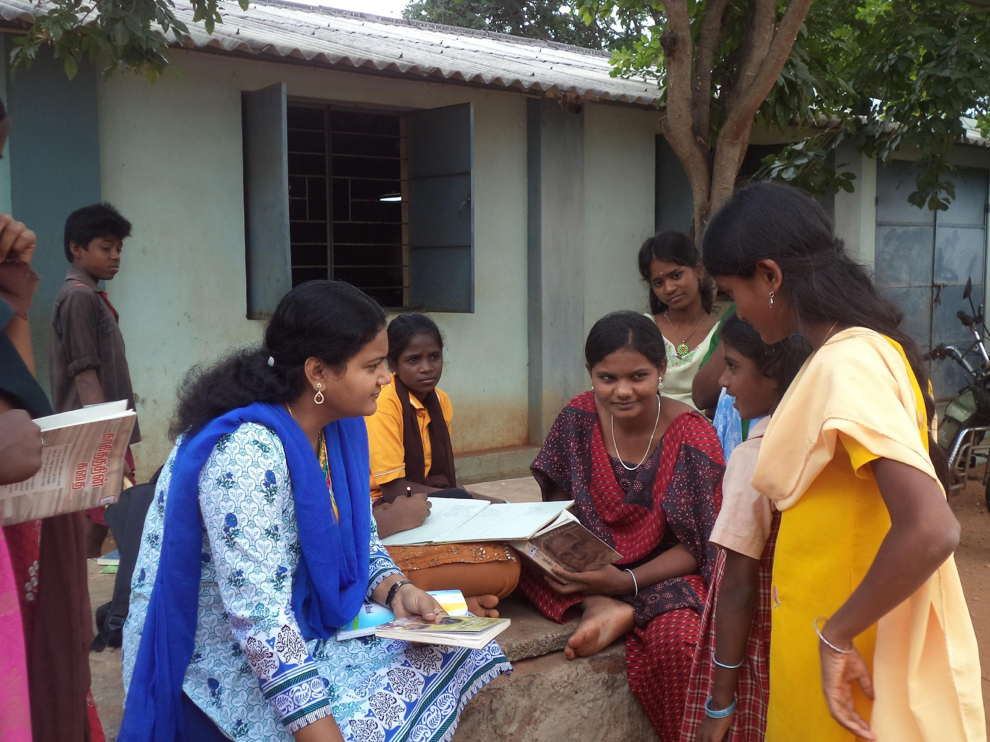
Find a Partner
© Miracle Foundation 2020

Slide 7
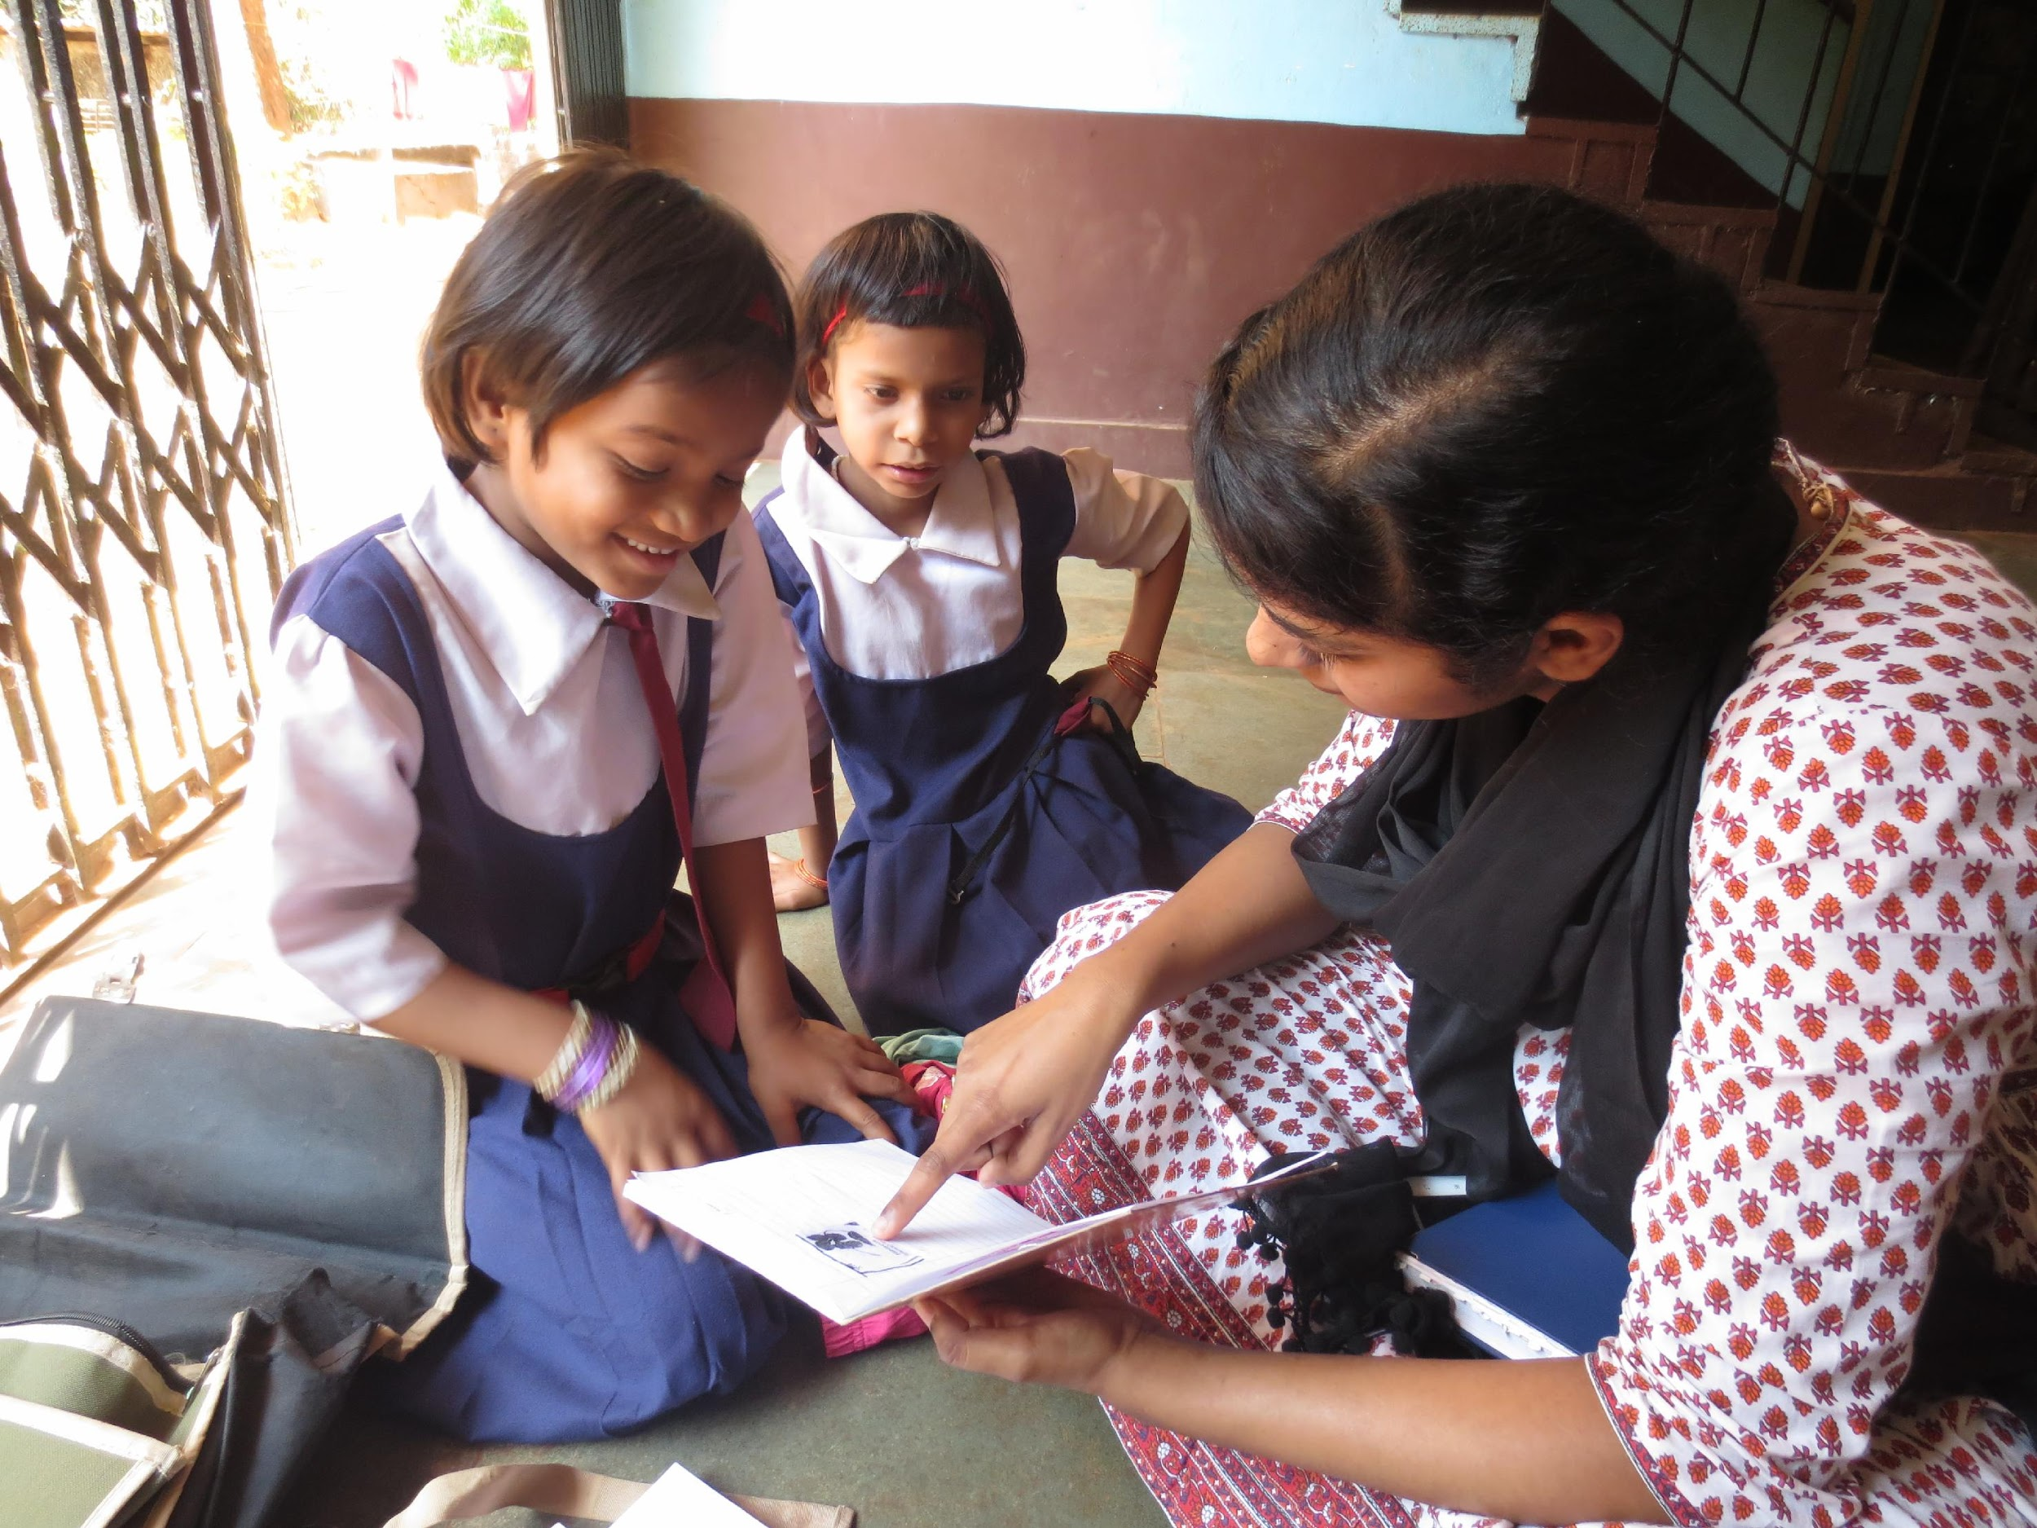
Identify Resources to Help You
© Miracle Foundation 2020

Slide 8
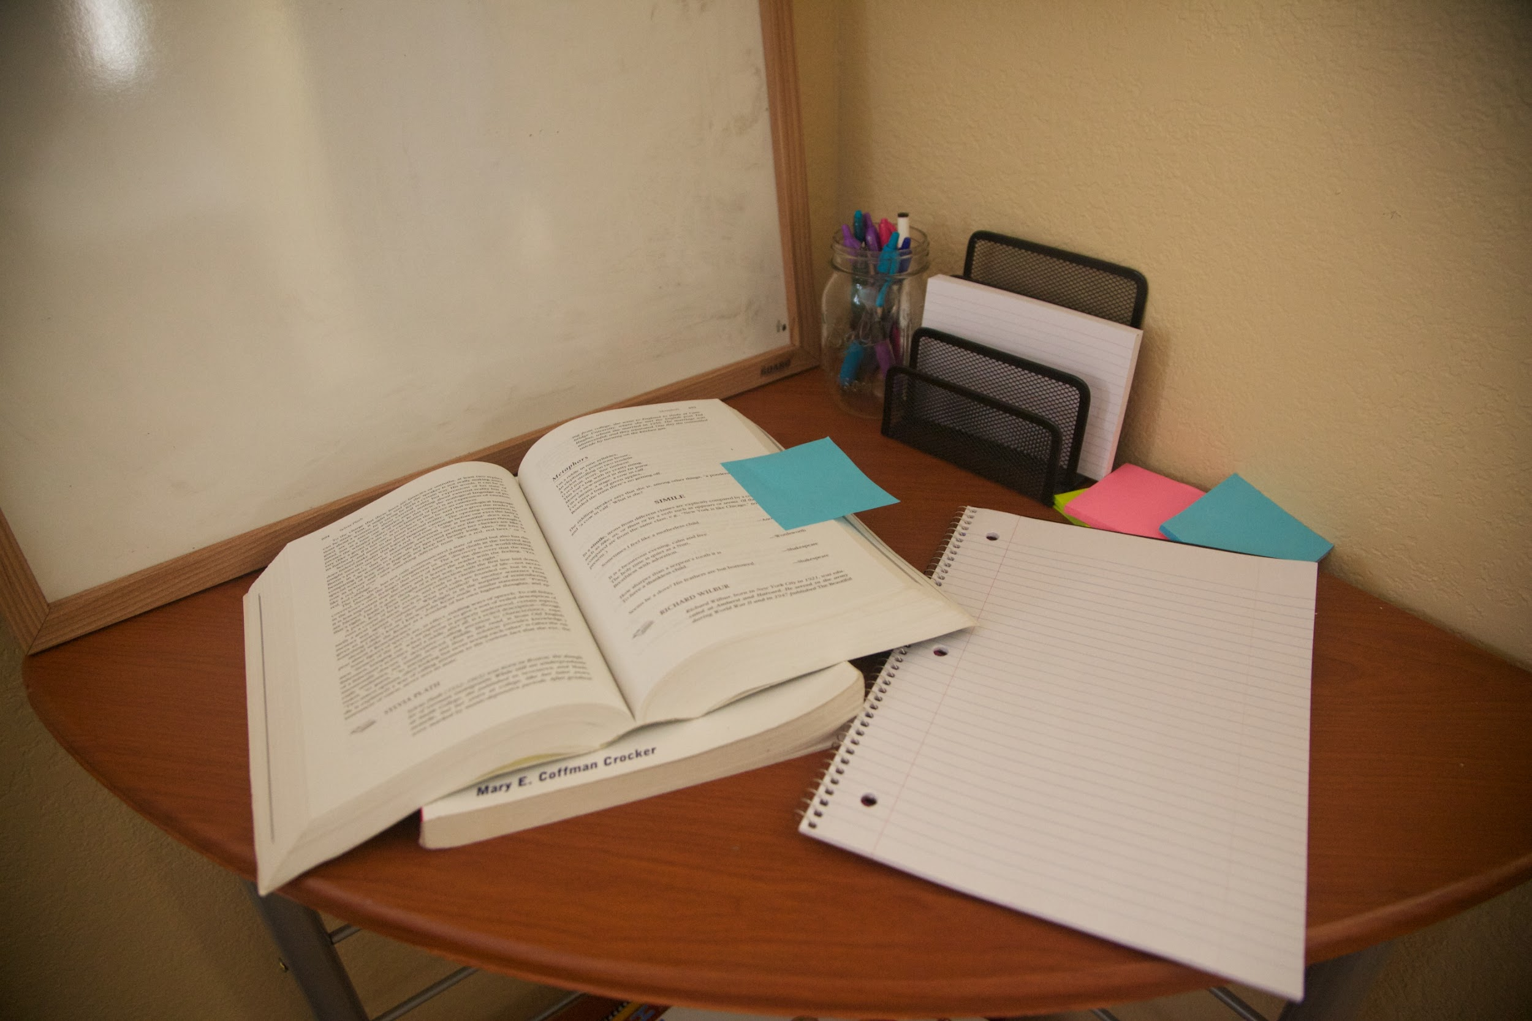
Comfortable Environment
© Miracle Foundation 2020

Slide 9
Take Breaks
© Miracle Foundation 2020

Slide 10
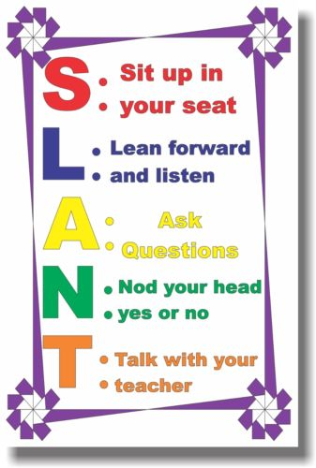
Use Motivational Posters
© Miracle Foundation 2020

Slide 11
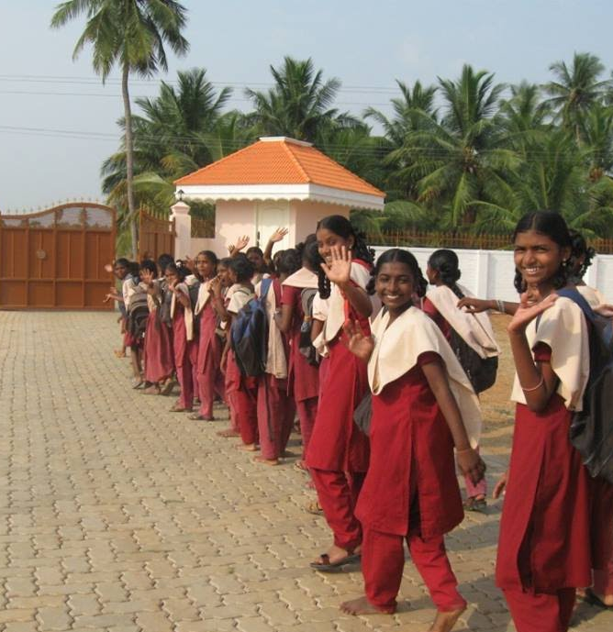
Just Do It!
© Miracle Foundation 2020

Slide 12
Thank you!
© Miracle Foundation 2020

