Slide 1
Values – What is important to me?
© Miracle Foundation 2020

Slide 2
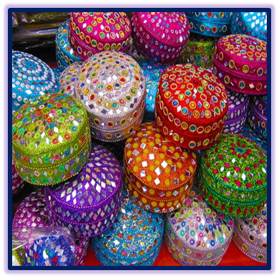
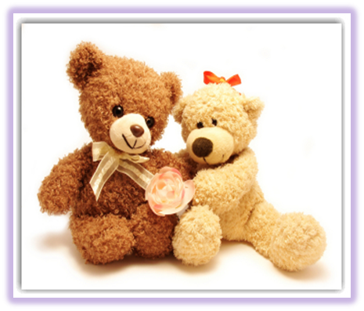
Tangible Items
© Miracle Foundation 2020

Slide 3
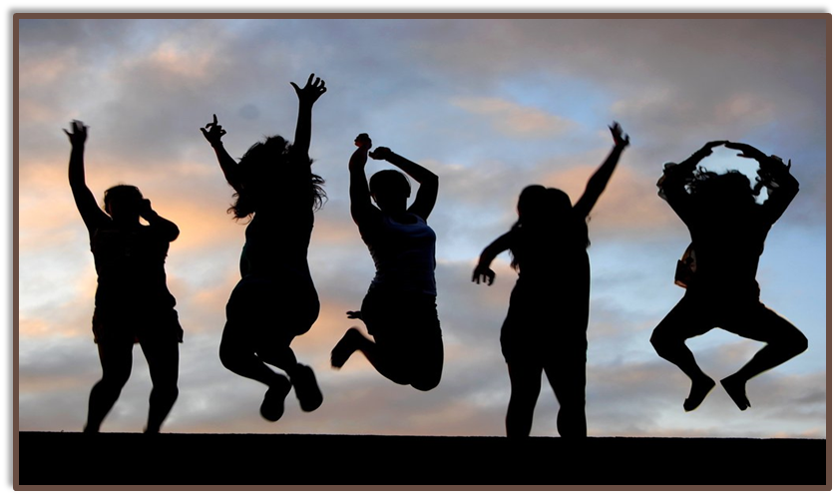
Values are Intangible Items
Friendship…Honesty…Fairness…
Courage…Personal Freedom
© Miracle Foundation 2020

Slide 4
Examples of Values
Having a friend I can always count on
Making a difference in the community
Having children when I am ready
Getting a good education
Being treated fairly
Taking care of others
Living according to my religious beliefs
© Miracle Foundation 2020

Slide 5
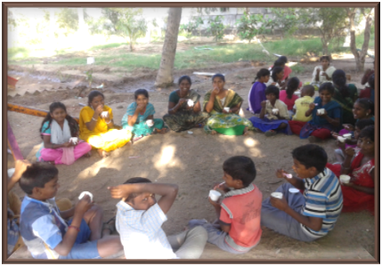
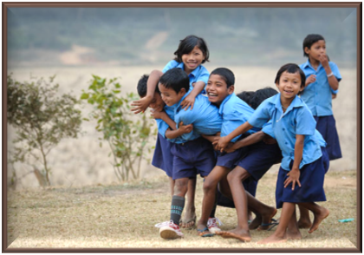
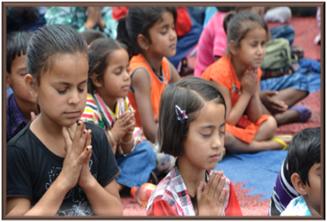
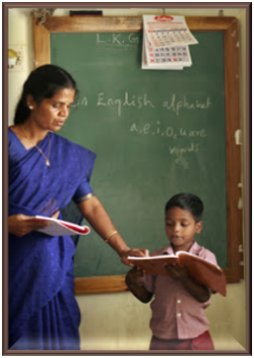
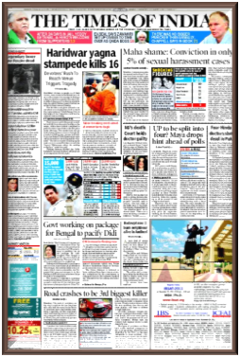
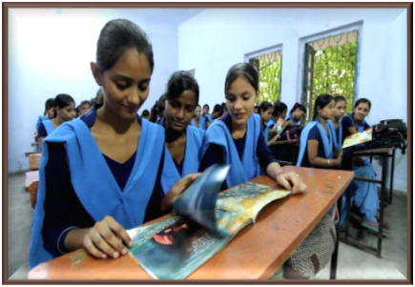
Where do you get your values?
Family Environment
Gender
Religious Teachings
People you look up to
School, Community, Society
Media
© Miracle Foundation 2020

Slide 6
Everyone has unique personal values
Can you think of a value someone else has that you do not share?
© Miracle Foundation 2020

Slide 7
Your values should guide your decisions and actions
© Miracle Foundation 2020

Slide 8
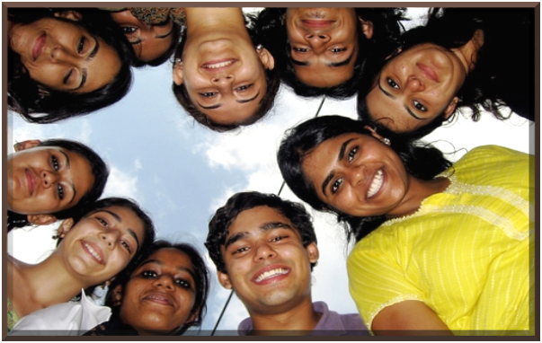
Your values
You live them
You develop them
Your friends have the same values
You make sacrifices to uphold your values
© Miracle Foundation 2020

Slide 9
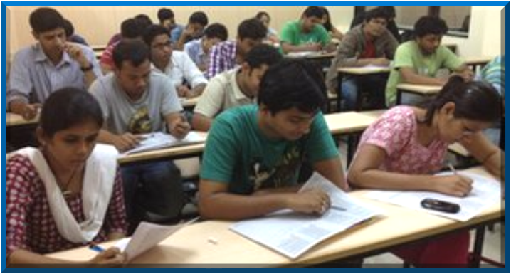
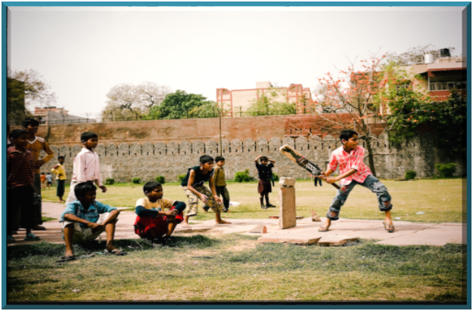
Values and Behavior
Values show up again and again in your actions
© Miracle Foundation 2020

Slide 10
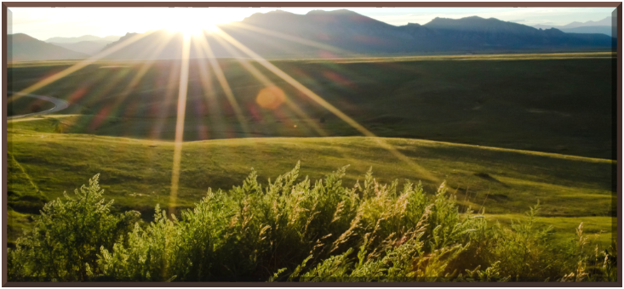
Your goals should reflect your values
“Keep your values positive because your values become your destiny.”
Mahatma Gandhi
© Miracle Foundation 2020

Slide 11
Sometimes it’s hard to know what we value
Identifying your values is an ongoing process.
It takes time to recognize what is really important to you.
Values can change over time.
© Miracle Foundation 2020

Slide 12
Thank you!
© Miracle Foundation 2020

