Slide 1
Goal Setting
© Miracle Foundation 2020

Slide 2
Why Set Goals
Makes you think about the possibilities
© Miracle Foundation 2020

Slide 3
Gives you direction to work toward
© Miracle Foundation 2020

Slide 4
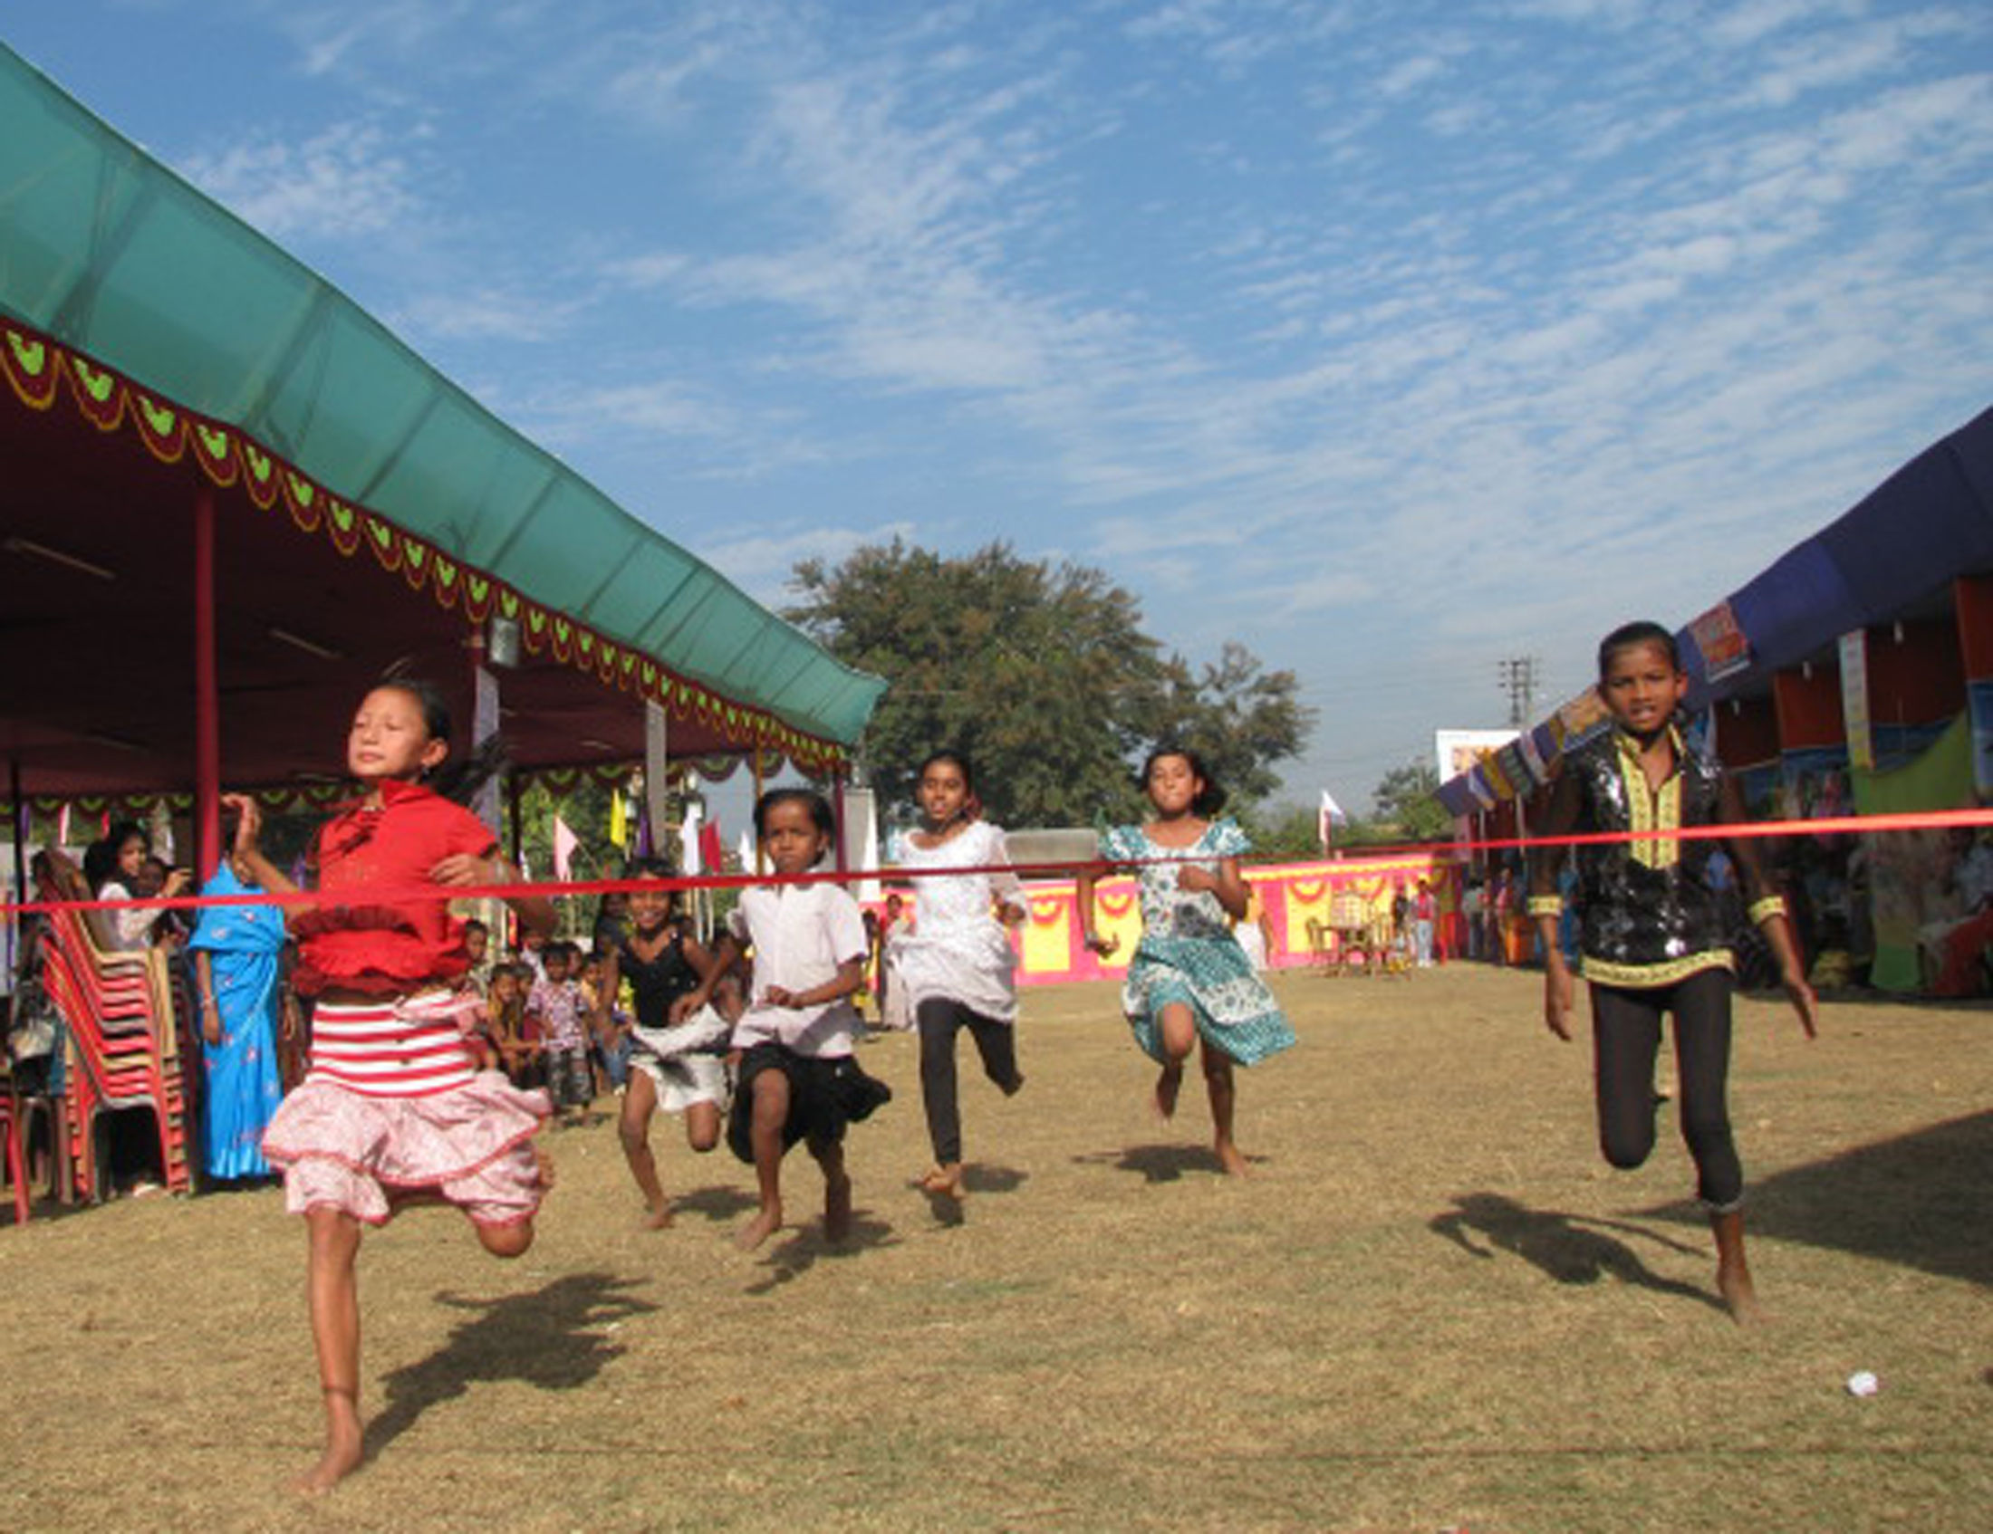
Helps you push yourself a little bit more
© Miracle Foundation 2020

Slide 5
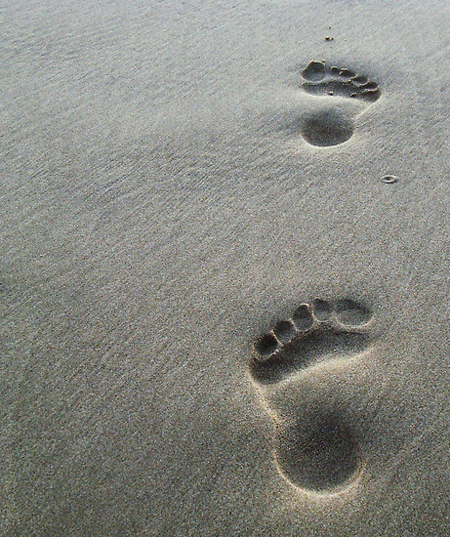
Breaks big goals into smaller steps
© Miracle Foundation 2020

Slide 6
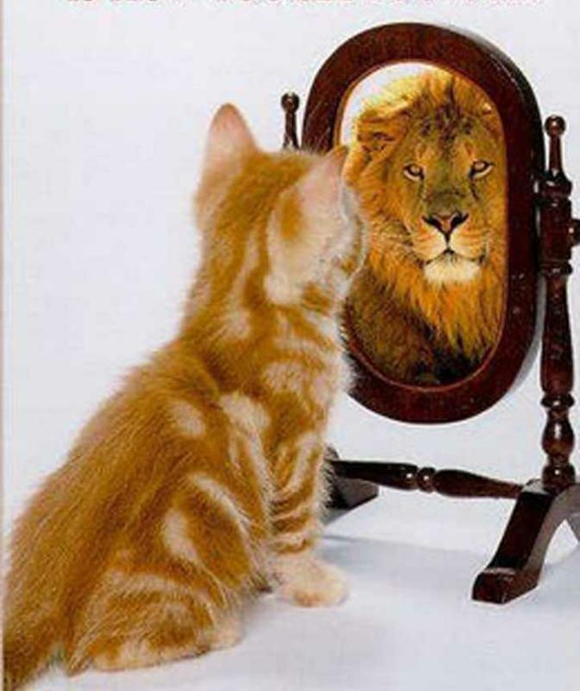
Helps you believe in yourself
© Miracle Foundation 2020

Slide 7
Helps you have a more fun and fulfilled life
© Miracle Foundation 2020

Slide 8
How do we set goals?
© Miracle Foundation 2020

Slide 9
Types of Goals
Goals
Long Term
Month, Year or More
Short Term
Within a day or week
© Miracle Foundation 2020

Slide 10
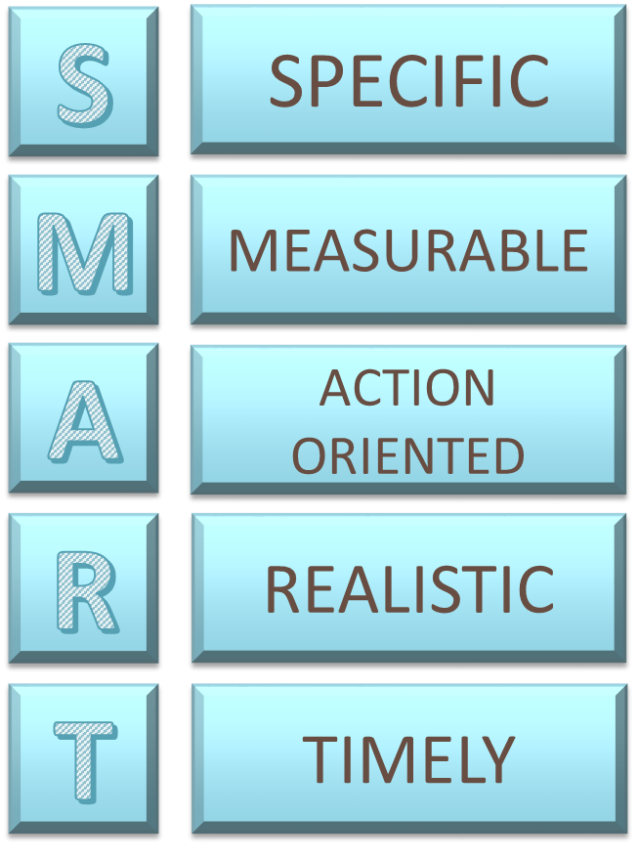
SMART Goals
© Miracle Foundation 2020

Slide 11
Specific
© Miracle Foundation 2020

Slide 12
Measurable
© Miracle Foundation 2020

Slide 13
Action Oriented
© Miracle Foundation 2020

Slide 14
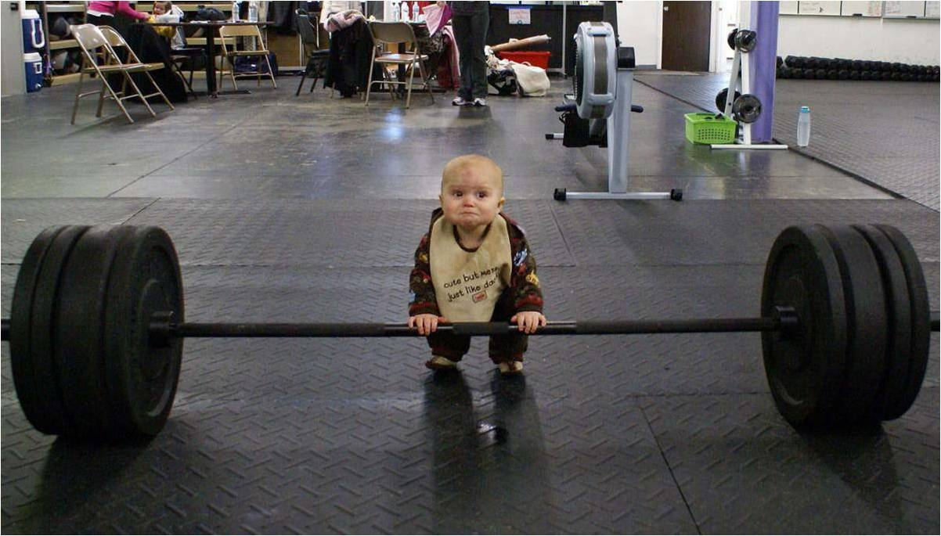
Realistic
© Miracle Foundation 2020

Slide 15
Timely
© Miracle Foundation 2020

Slide 16
Set a Goal, Make it Happen
© Miracle Foundation 2020

Slide 17
Thank you!
© Miracle Foundation 2020

