Slide 1
Making Friends
© Miracle Foundation 2020

Slide 2
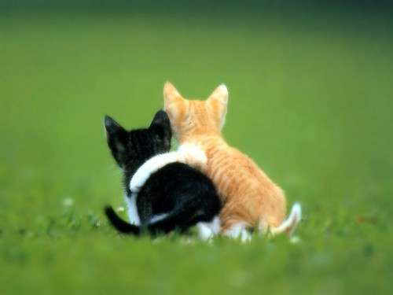
To have good friends, you need to be a good friend
© Miracle Foundation 2020

Slide 3
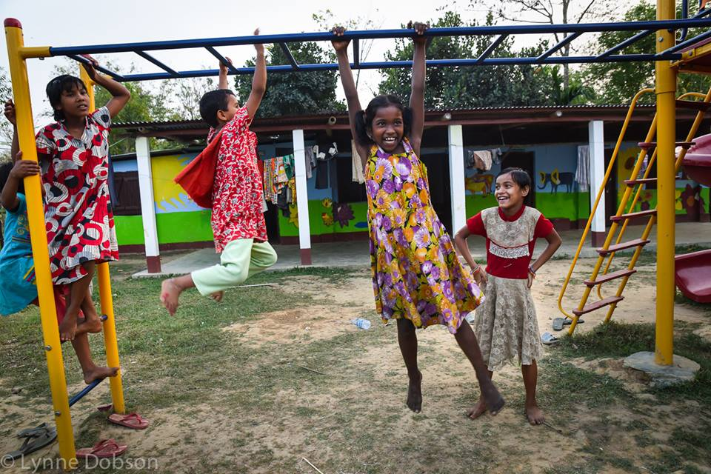
Getting started
© Miracle Foundation 2020

Slide 4
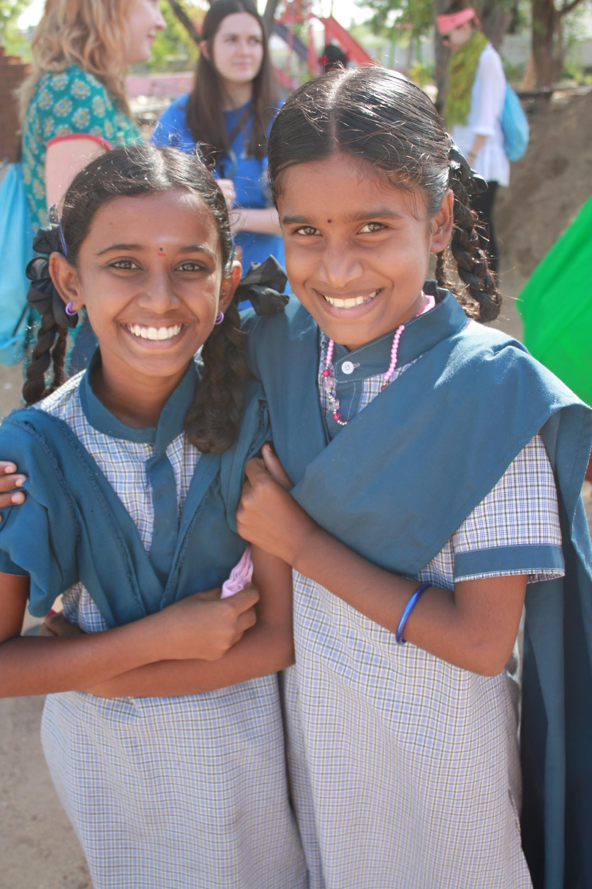
Look friendly
© Miracle Foundation 2020

Slide 5
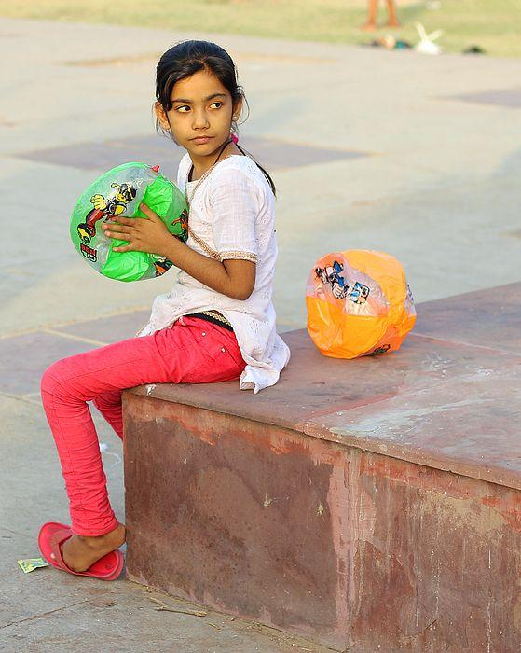
Look for kids who are alone or shy
© Miracle Foundation 2020

Slide 6
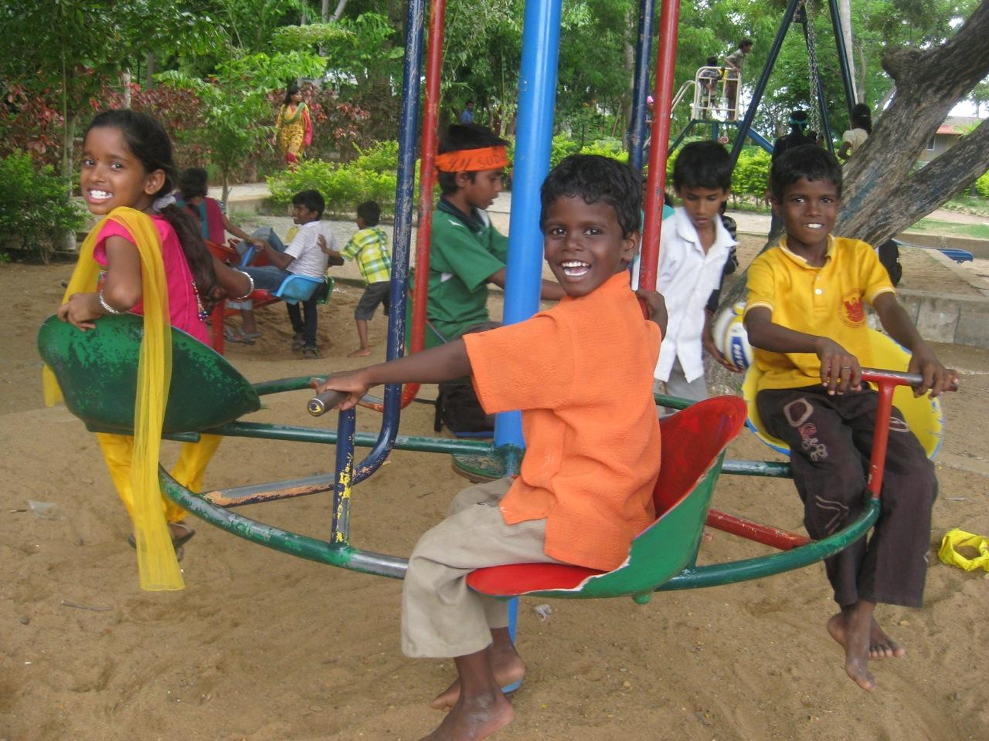
Hang out near a group
© Miracle Foundation 2020

Slide 7
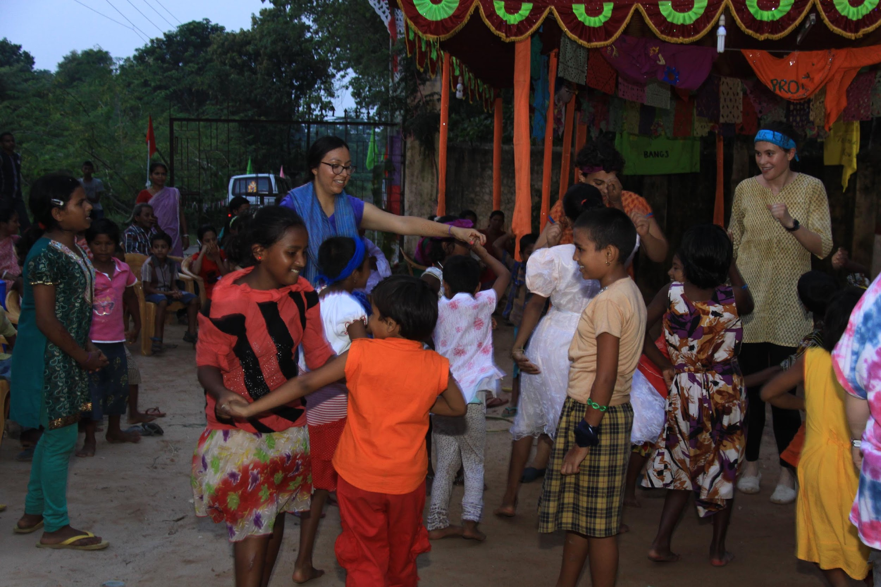
Look for eye contact and smile!
© Miracle Foundation 2020

Slide 8
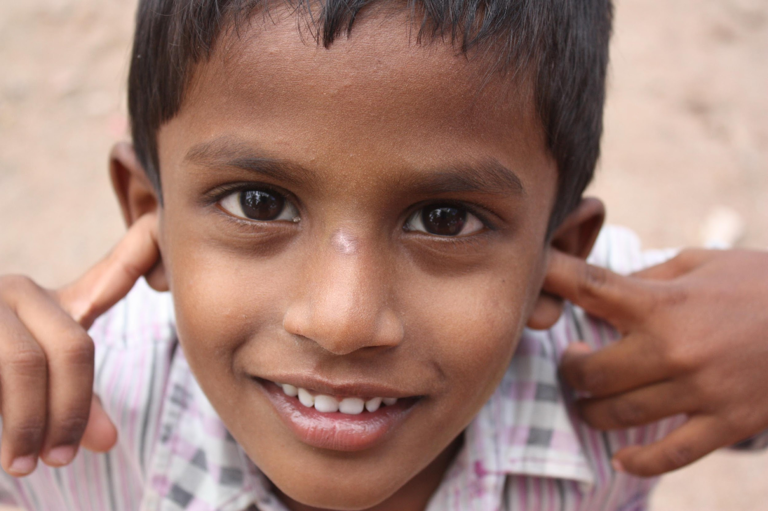
Listen then join in
© Miracle Foundation 2020

Slide 9
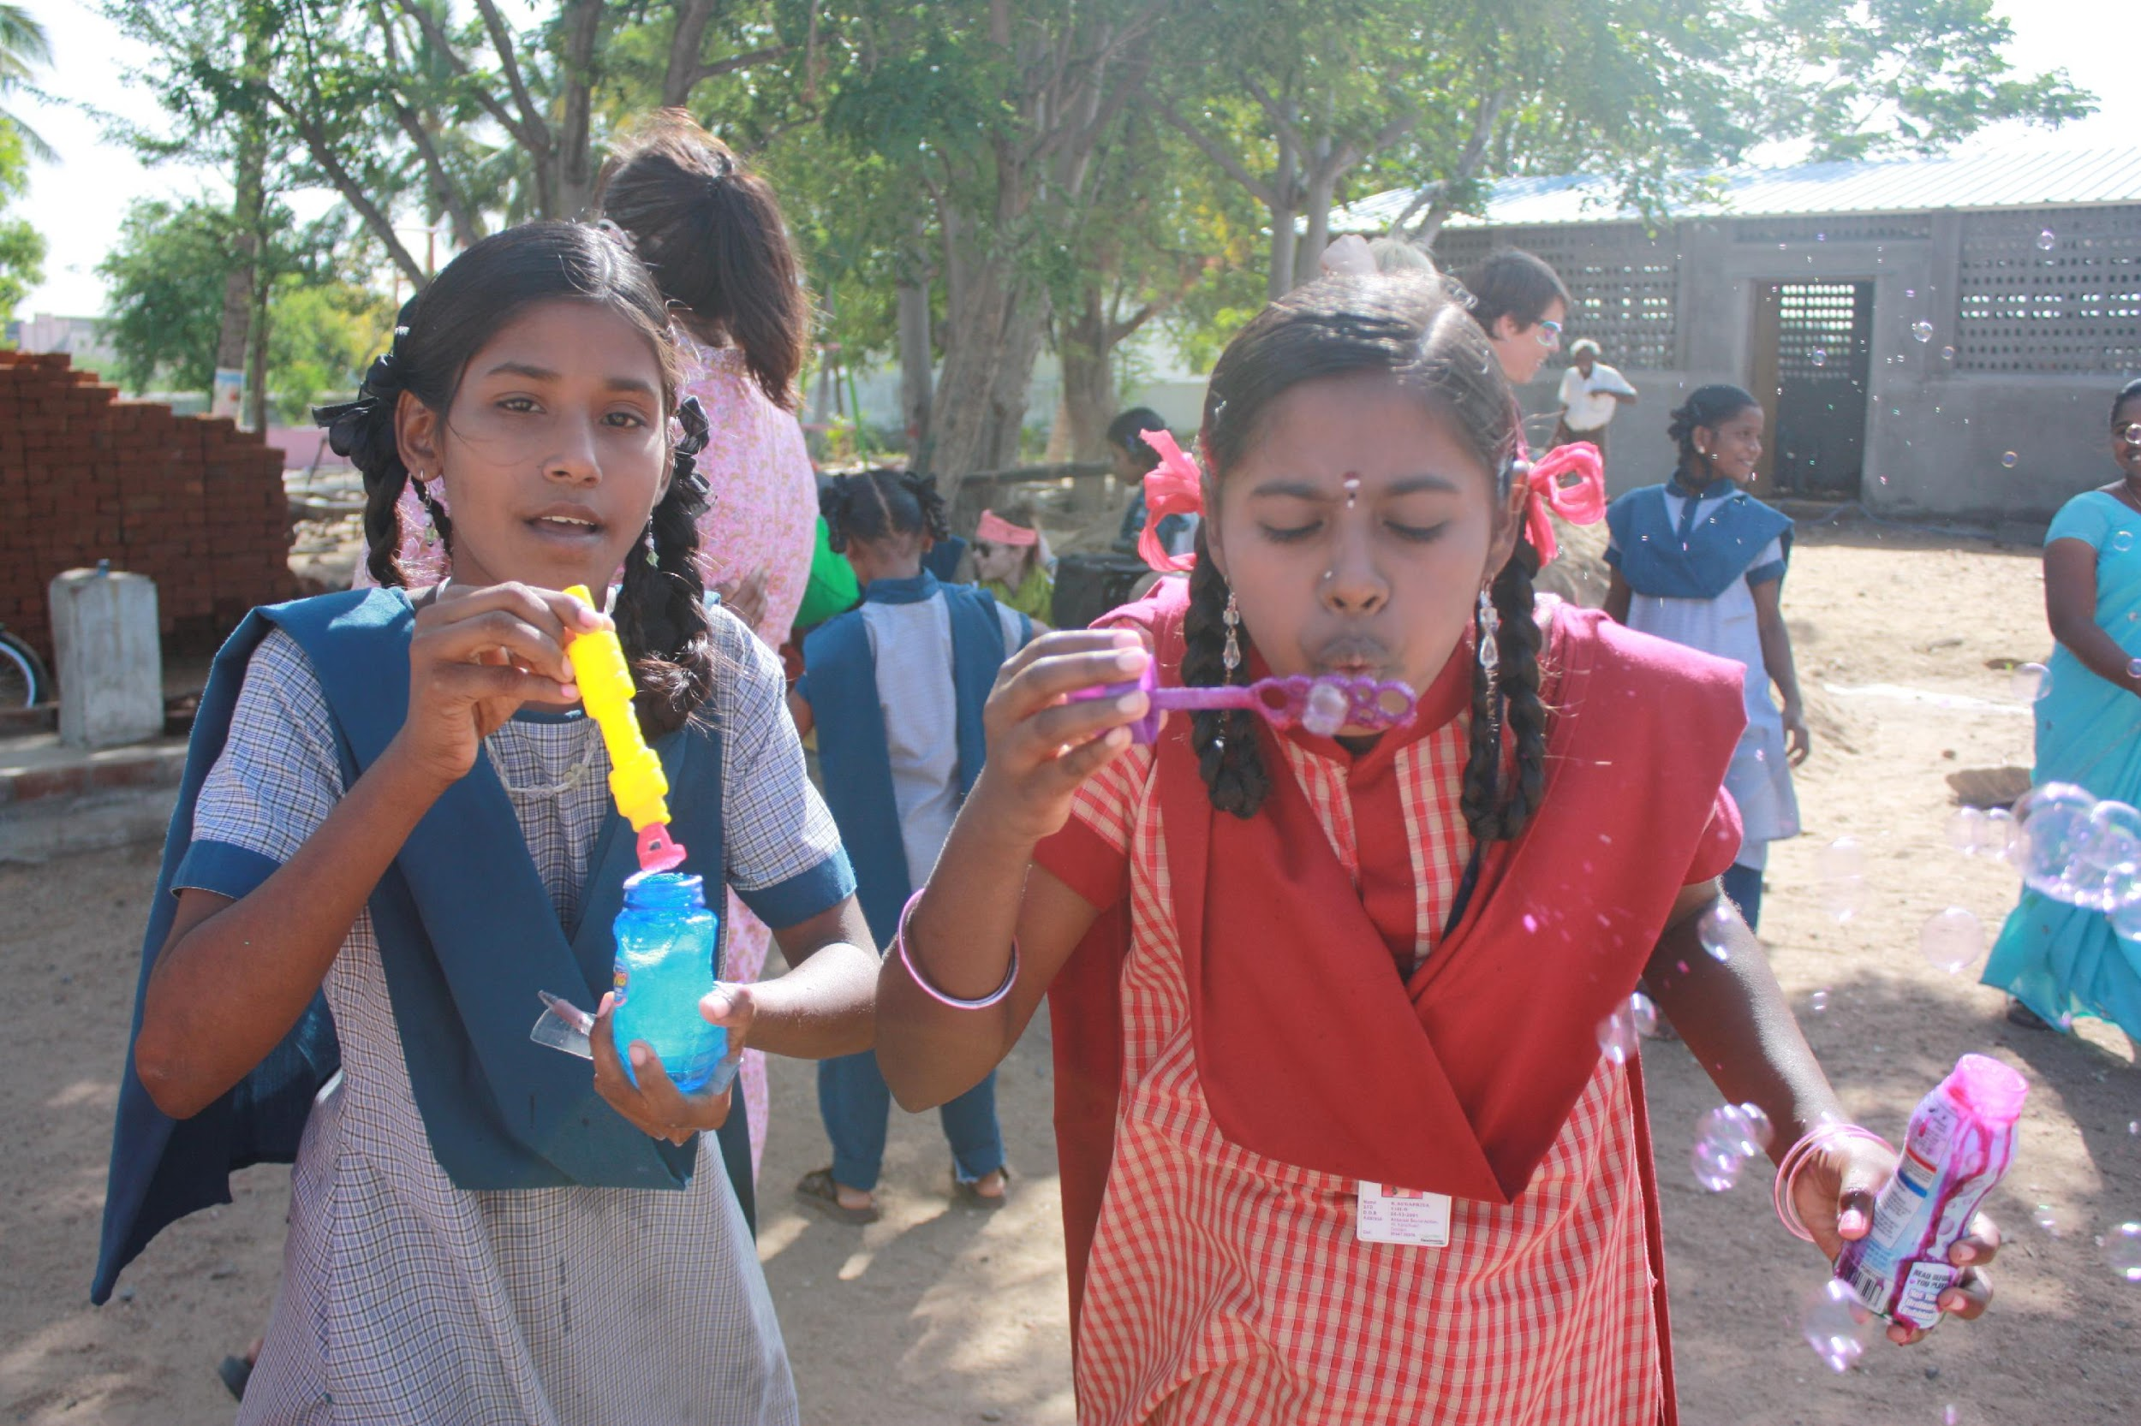
Join in
© Miracle Foundation 2020

Slide 10
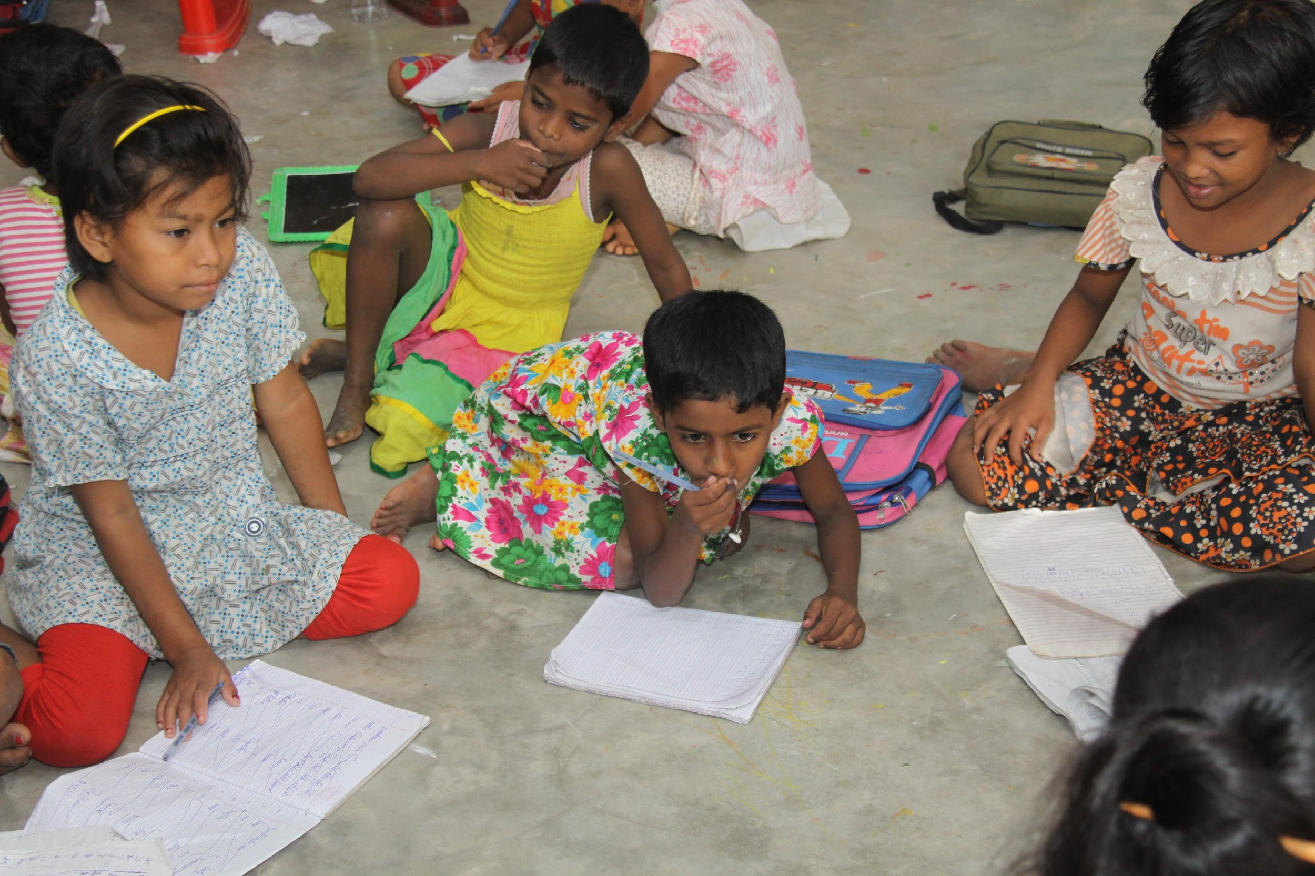
Think about what you want to say
© Miracle Foundation 2020

Slide 11
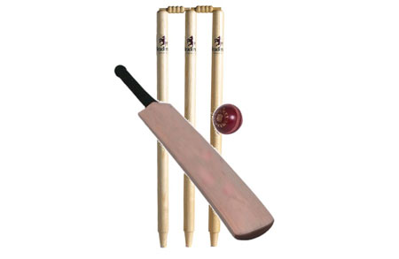
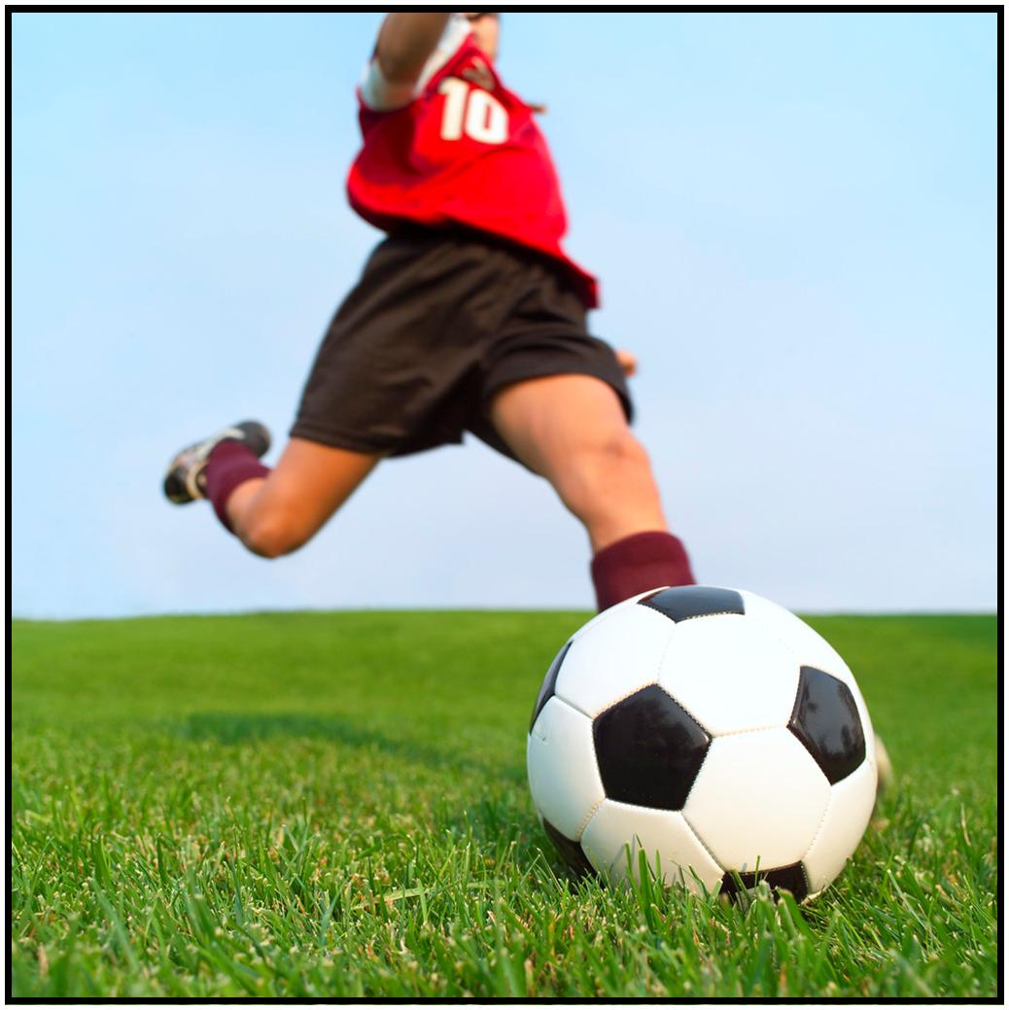

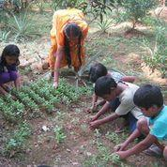

Share information about yourself
© Miracle Foundation 2020

Slide 12
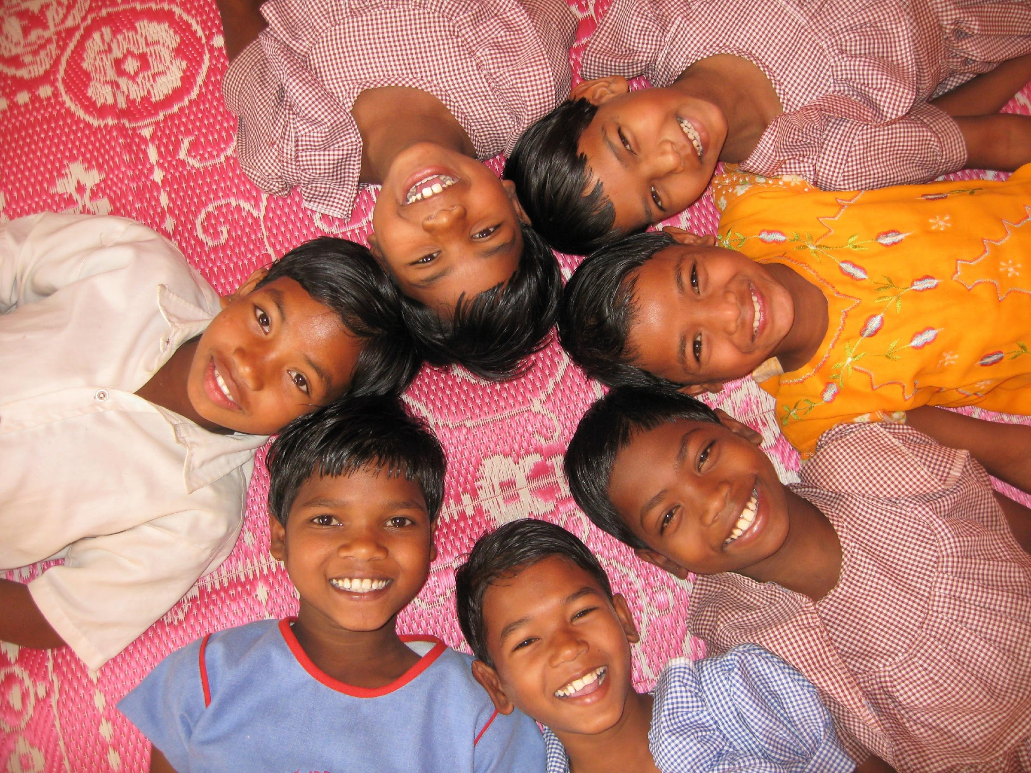
Be positive
© Miracle Foundation 2020

Slide 13
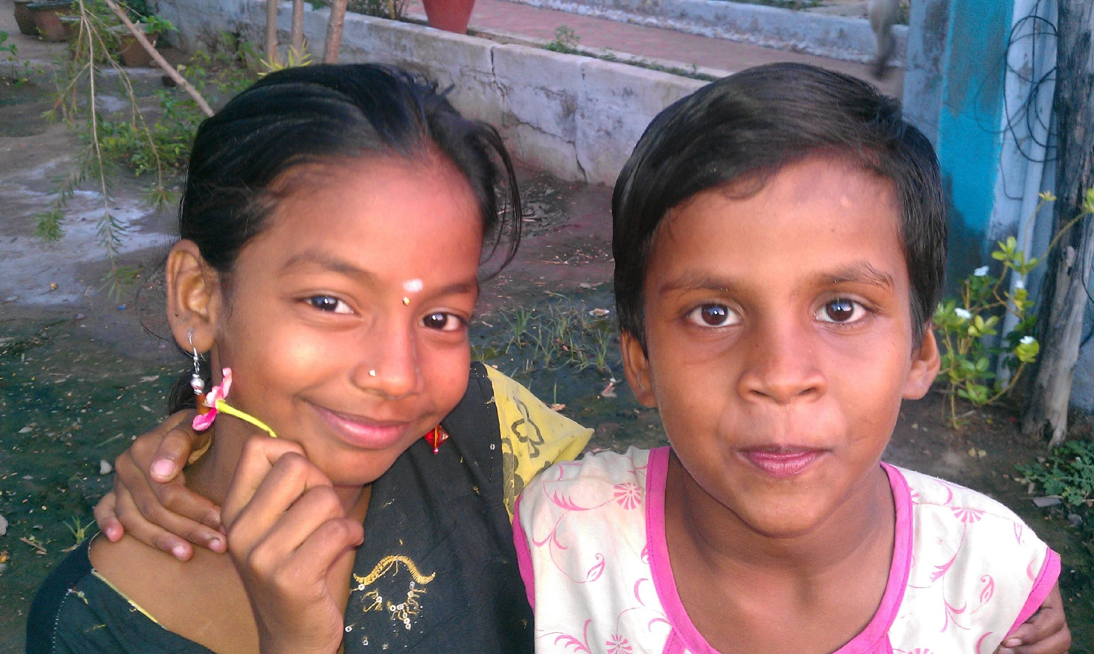
Share the conversation
© Miracle Foundation 2020

Slide 14
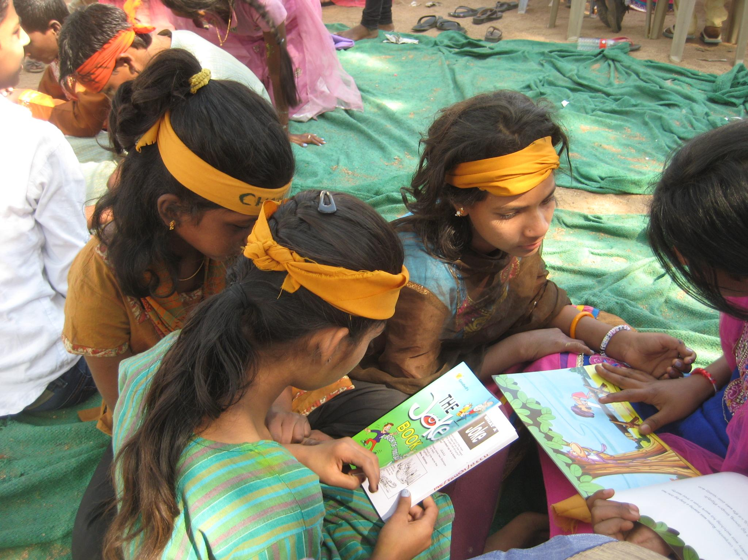
Listen!
© Miracle Foundation 2020

Slide 15
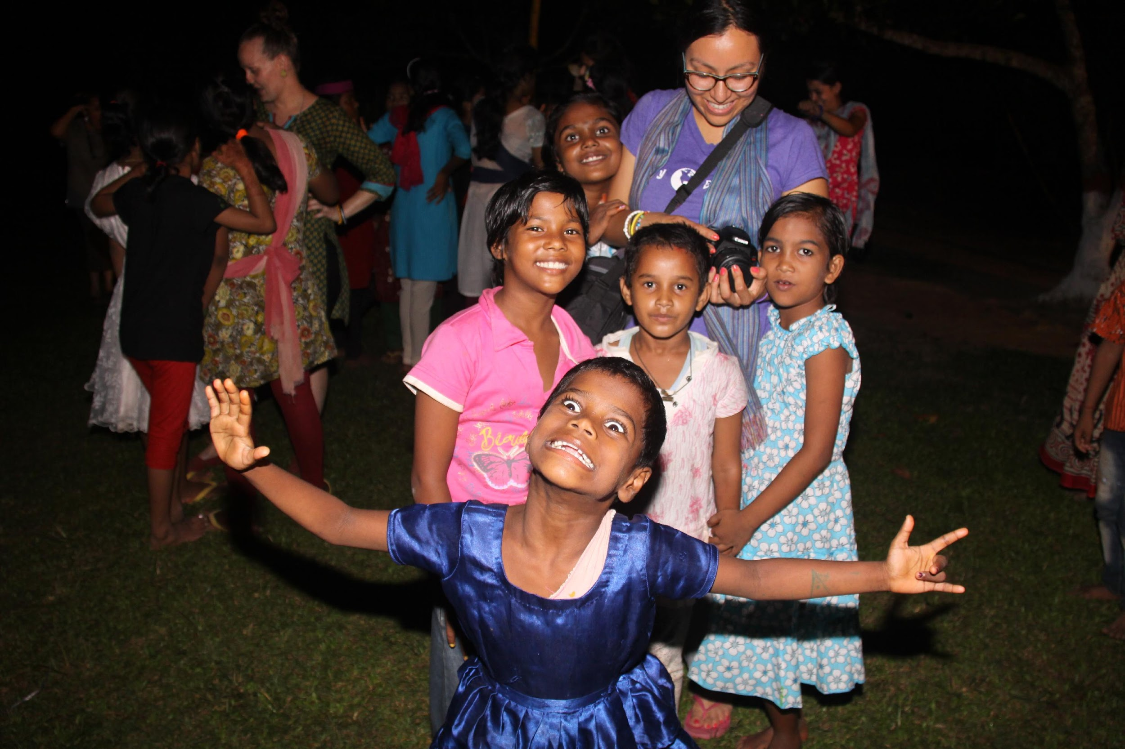
Be yourself
© Miracle Foundation 2020

Slide 16
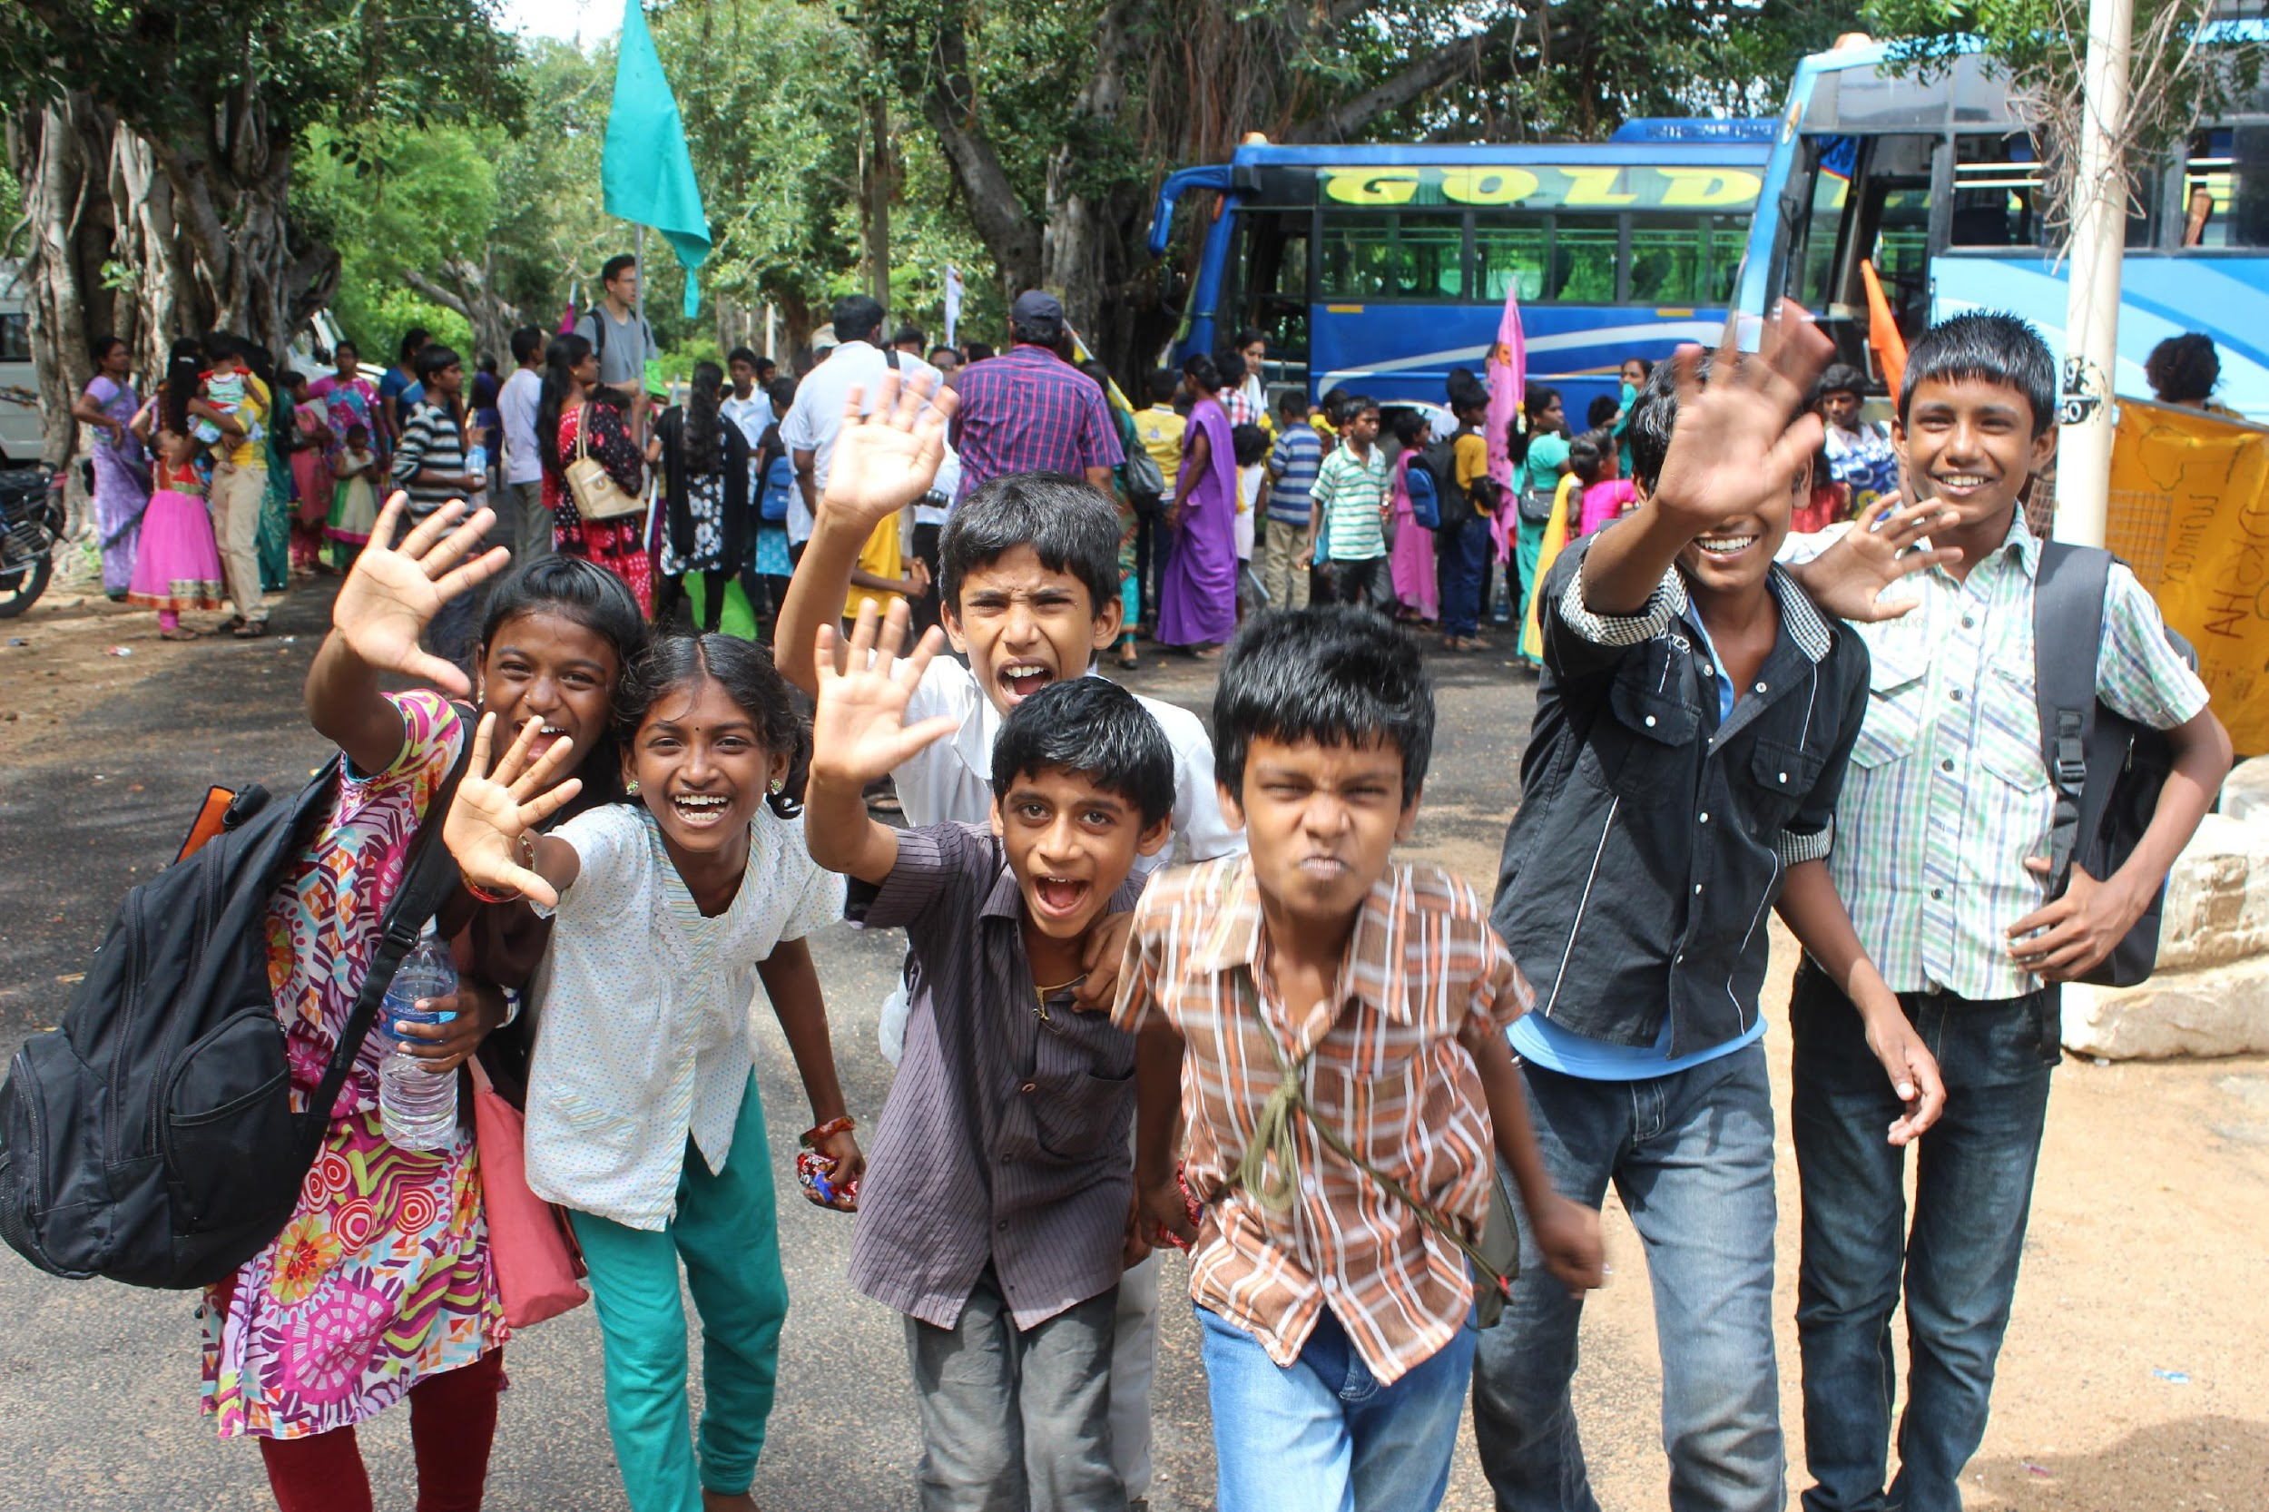
Don’t worry
© Miracle Foundation 2020

Slide 17
Thank you!

