Slide 1
Qualities of a Good Friend
© Miracle Foundation 2020

Slide 2
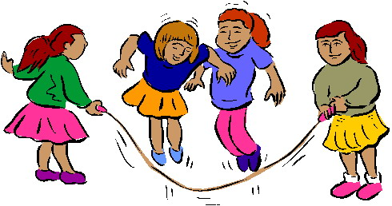
Take Turns
© Miracle Foundation 2020

Slide 3
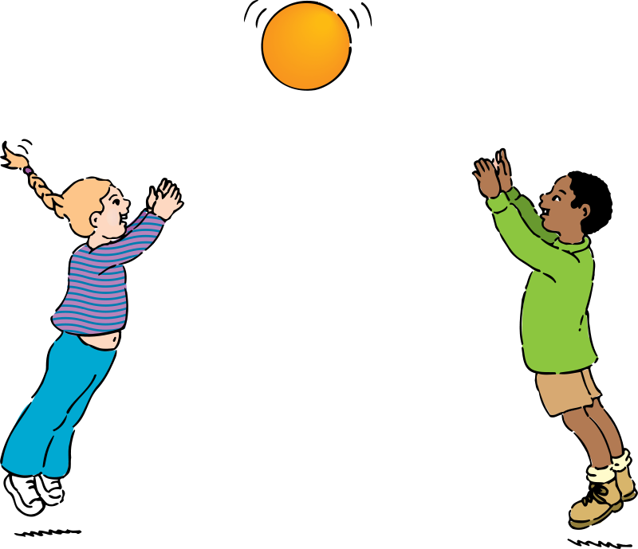
Share
© Miracle Foundation 2020

Slide 4
Do Your Part
© Miracle Foundation 2020

Slide 5
Listen
© Miracle Foundation 2020

Slide 6
Be Polite
© Miracle Foundation 2020

Slide 7
Be Patient
© Miracle Foundation 2020

Slide 8
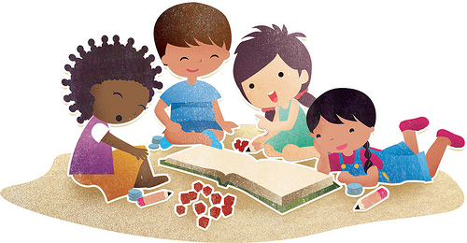
Be Helpful
© Miracle Foundation 2020

Slide 9
Thank you!
© Miracle Foundation 2020

