Slide 1
Stress Management

Slide 2
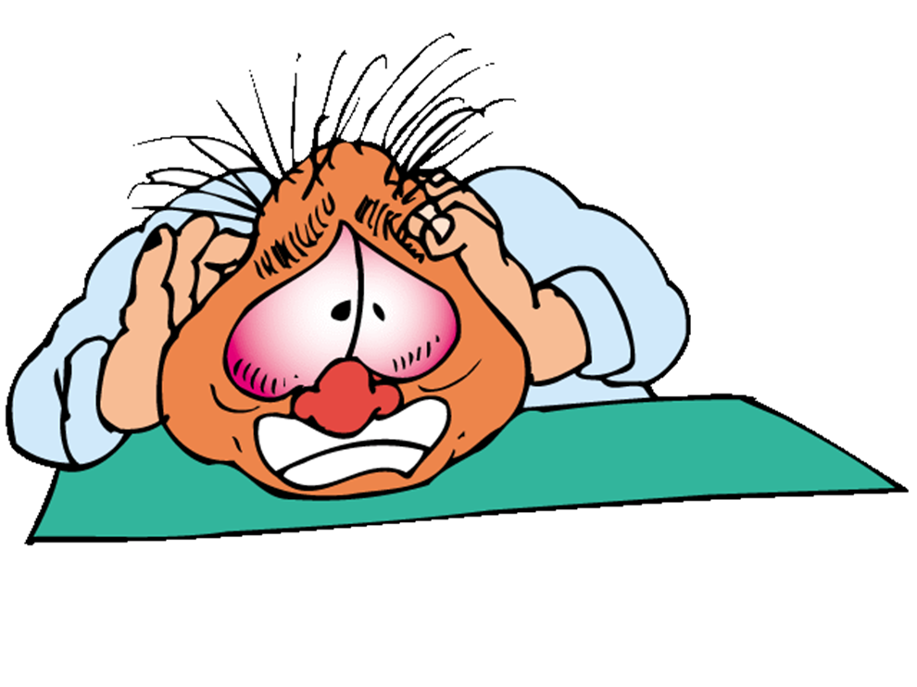
What is stress?

Slide 3
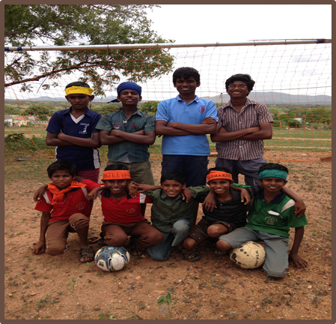
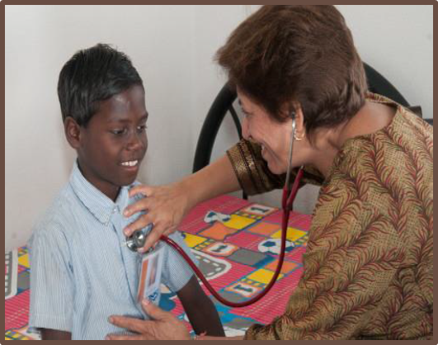
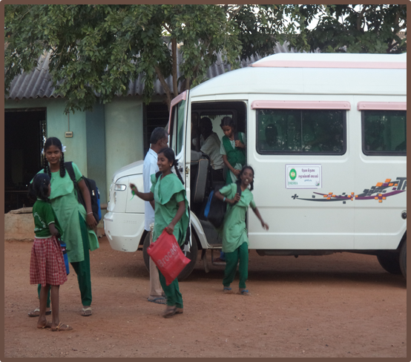
Stress is the body’s natural reaction to changes and challenges
Illness
Sports
School

Slide 4
Stress is the body’s way of preparing to meet a tough situation
Stamina
Focus
Strengthl

Slide 5
Some level of stress is normal for everyone, but too much is overwhelming

Slide 6
We all react to stress in different ways
Anger
Sadness
Frustration

Slide 7
Pause til Part 4

Slide 8
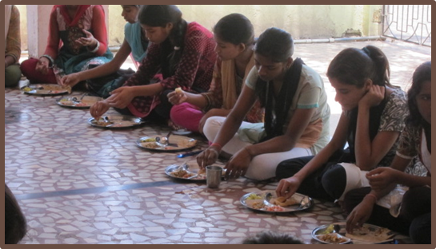
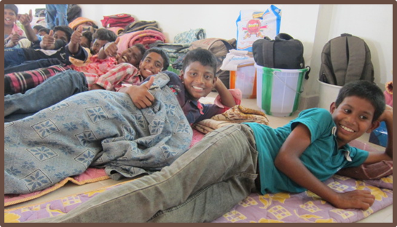
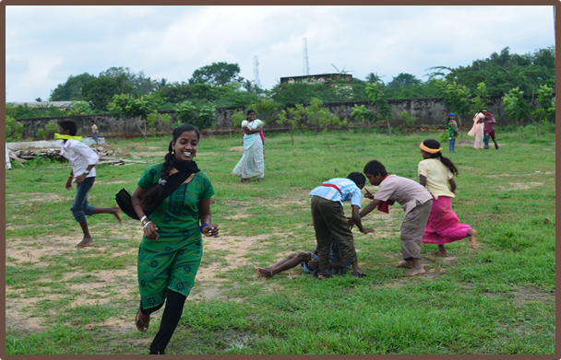
Ways to keep stress under control
Eat Well
Get Good Sleep
Exercise

Slide 9
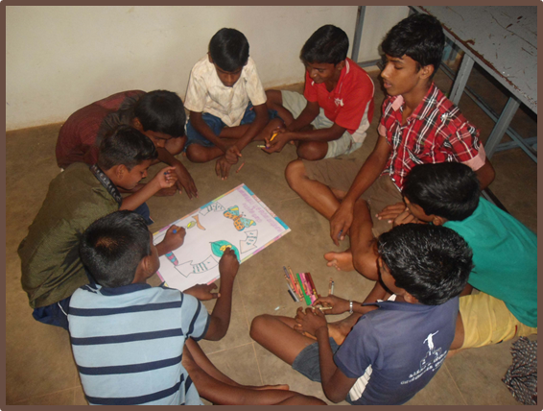
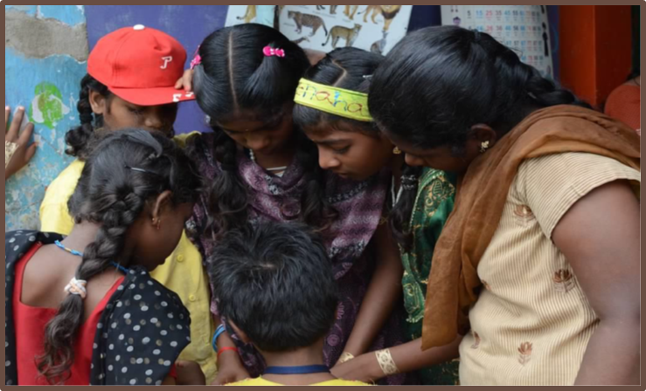
Use your life skills
Problem Solving
Communication

Slide 10
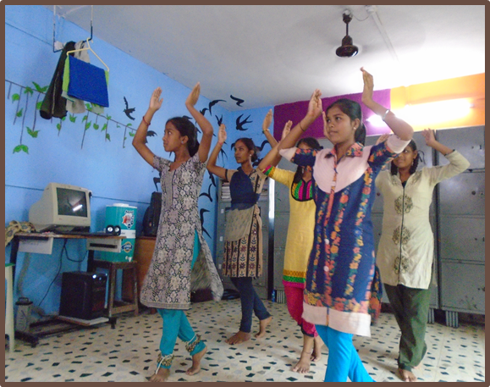
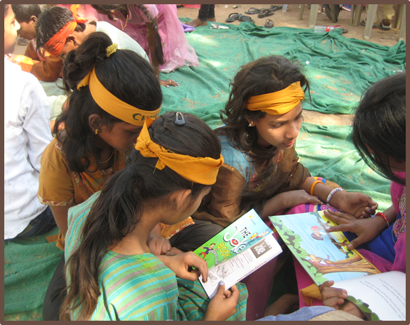
Do things that make you happy
Dance
Spend time with friends

Slide 11
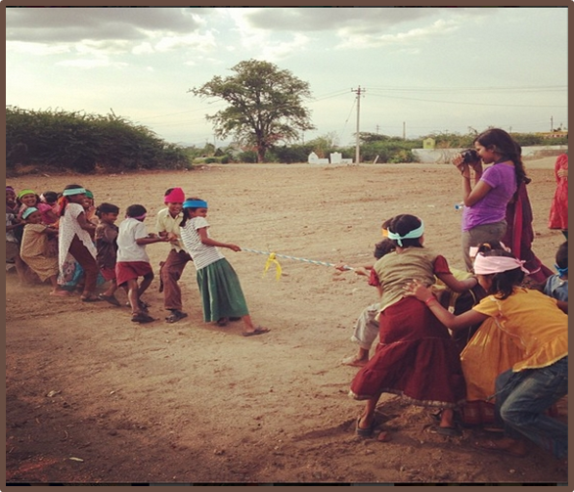
Be realistic
Focus on your strengths
Don’t try to be perfect

Slide 12
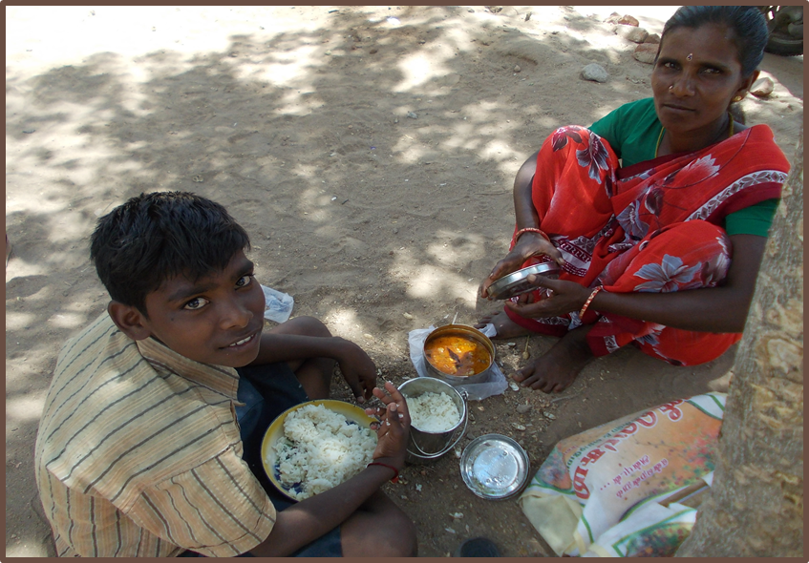
Talk to someone

Slide 13
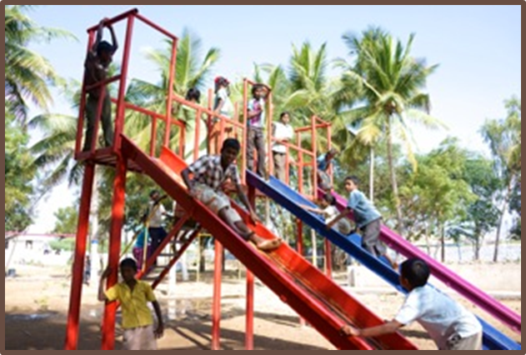
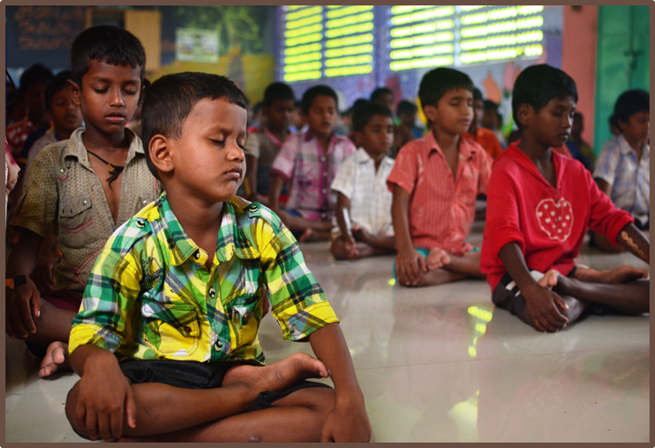
Learn to relax

Slide 14
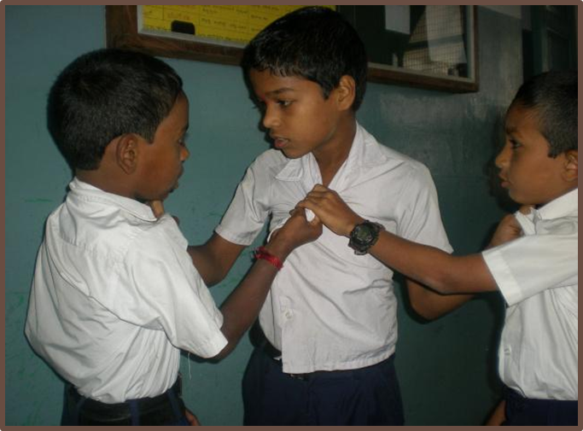
Negative ways to deal with stress
Bullying
Fighting
Skipping school
Alcohol, drugs

Slide 15
Signs you should seek help
Grades are dropping
Tired all the time
Headaches, stomach aches
Feeling sad or hopeless

